Slide 1
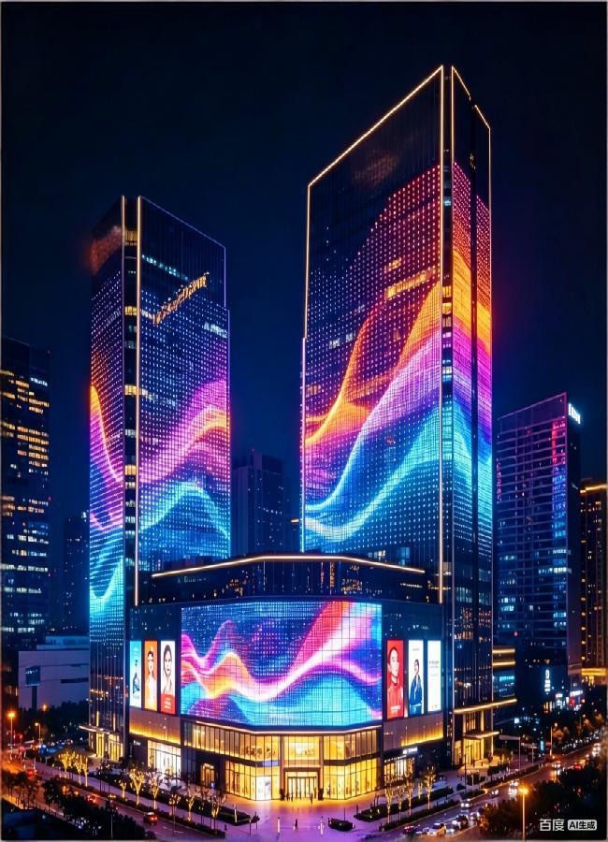

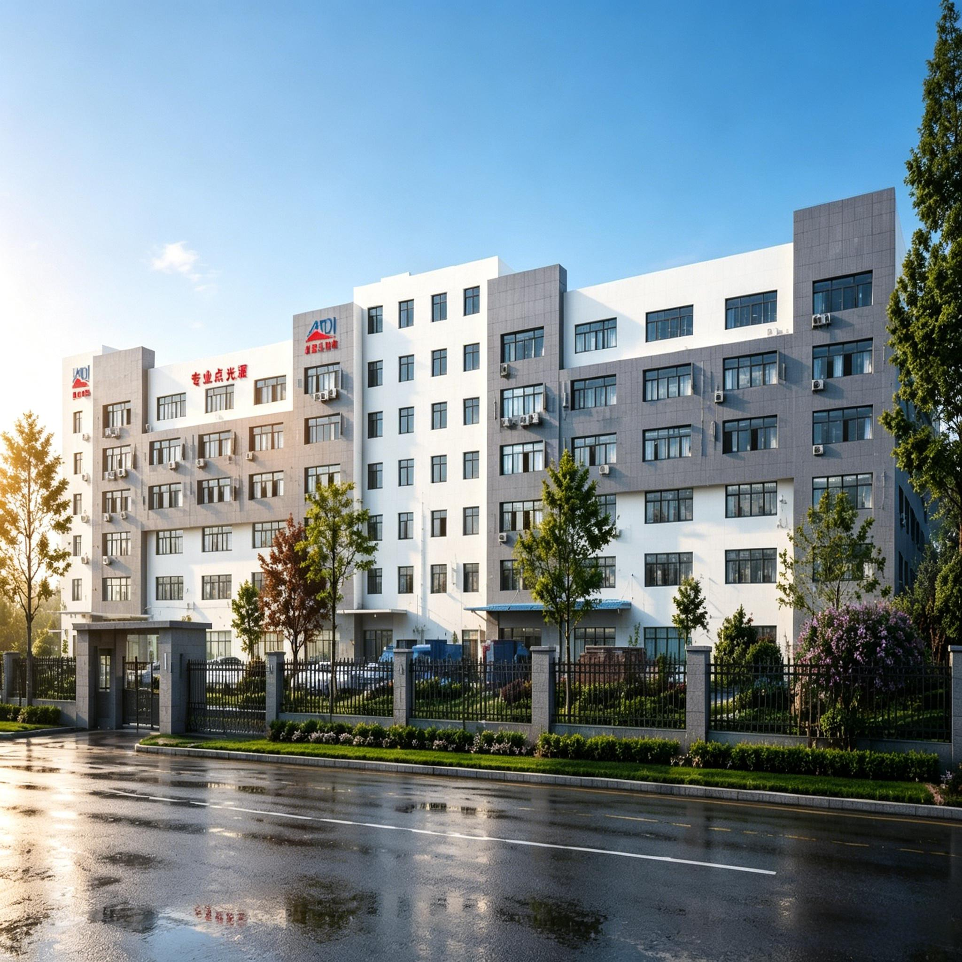
Light up the world
Create classics
MKL
Guangdong MeiDile International Lighting Co., Ltd.
Address: 6th Floor, No. 398 Haizhou East North Road, Guzhen Town, Zhongshan City, Guangdong
Website: ledmediafacade.com
Tel: 0760 8983 9482

Slide 2
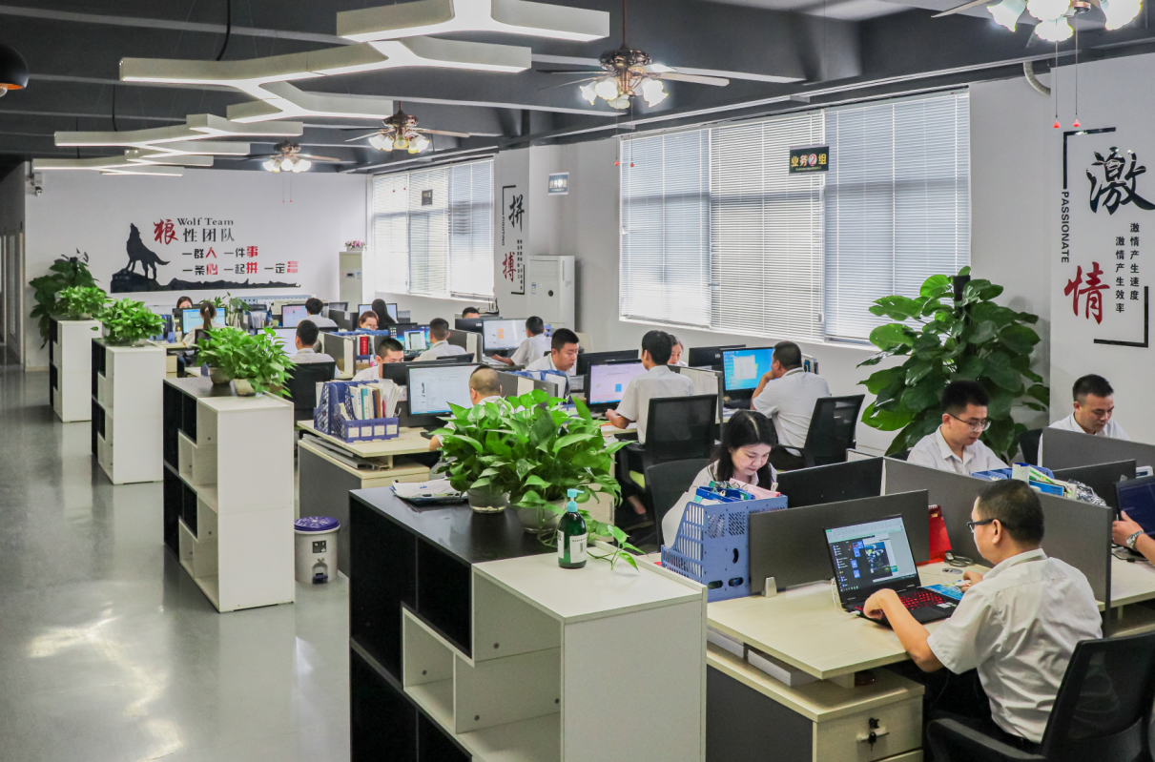
LED Landscape Lighting Service Team
Company Profile
Guangdong Meidile Lighting was founded in 2009. It is a modern lighting enterprise integrating R&D, production, sales and services.
Its flagship products are mainly applied to advertising lighting and urban lighting sectors. Equipped with professional teams for design, animation and construction guidance, the company can provide one-stop solutions and after-sales maintenance services.
The company is fully furnished with complete facilities and has built professional laboratories. It has upgraded production lines and independently developed advanced equipment such as point light source systems, so as to strictly control product quality and delivery efficiency.
Attaching great importance to talent development, the company brings together professionals in optoelectronics and architecture. It devotes itself to technological innovation and engineering design, and always takes the introduction, absorption and innovation of production technologies as a key measure to enhance its core competitiveness.
Upholding a professional and dedicated work philosophy, and relying on high and new technologies, exquisite craftsmanship and comprehensive after-sales services, the company has undertaken numerous large-scale lighting projects and maintained long-term partnerships with China's top 100 enterprises.
Taking into account national conditions and actual project conditions of various regions, it has explored and summarized a new set of ideas for the design and construction of lighting projects that align with international standards while featuring its own unique strengths.
Medile prioritizes quality, embraces innovation and upholds integrity. We specialize in delivering high-quality smart landscape lighting products and comprehensive solutions, offering cost-effective products and professional supporting services to clients.
In recent years, Medile has provided professional supporting products and all-round solutions for large-scale landscape lighting projects in Guangzhou, Shanghai, Hangzhou, Anhui and other regions.

Slide 3
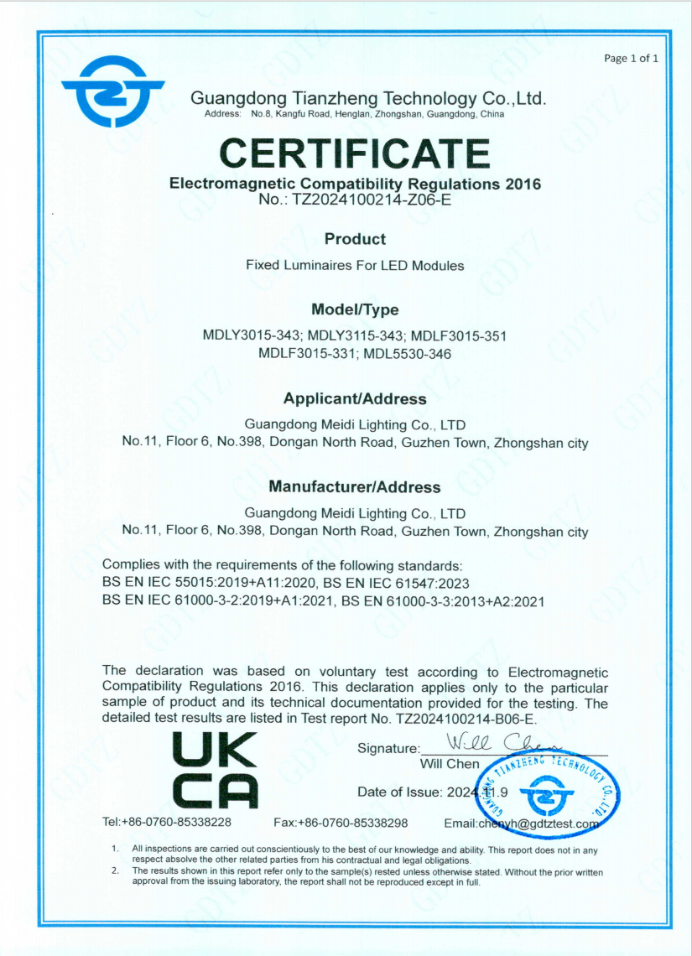
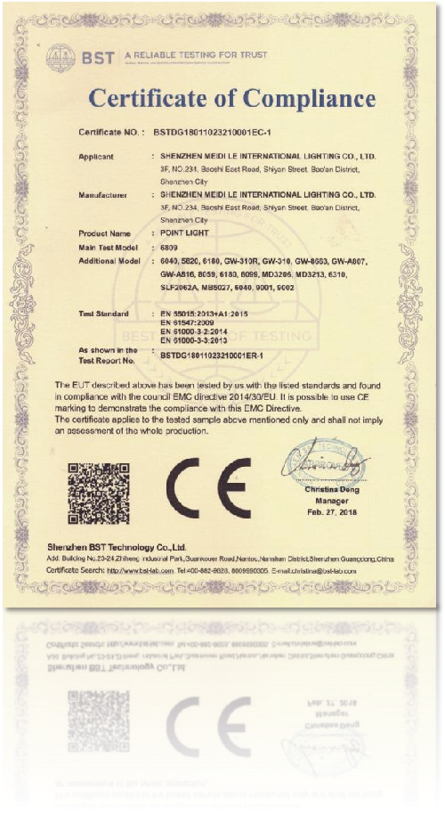
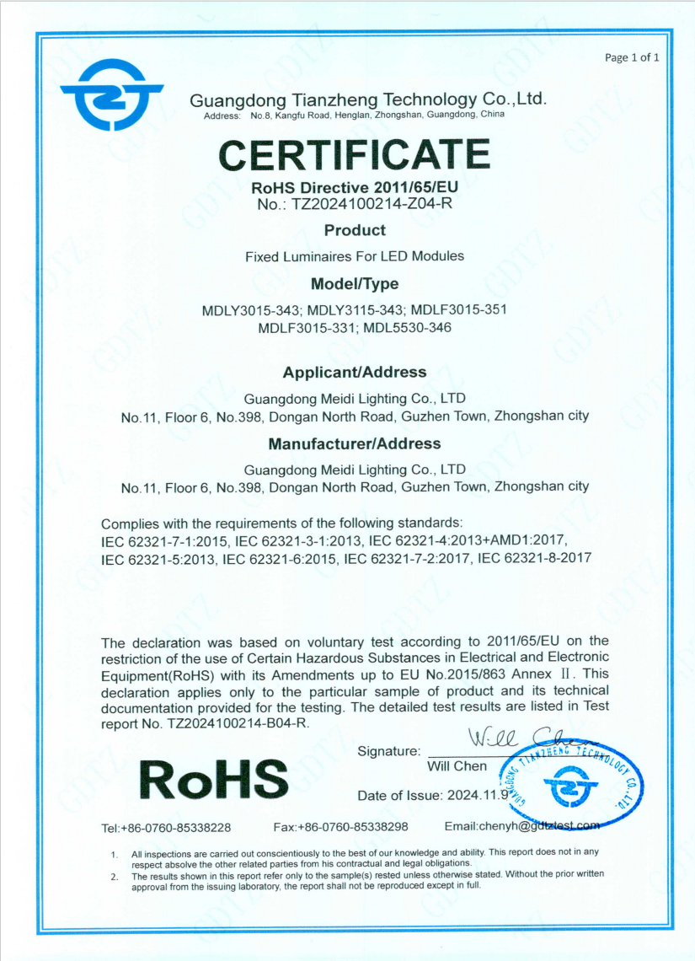
Enterprise Certificate
Certifications
&
Quality Assurance

Slide 4
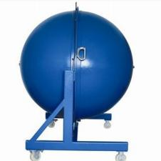
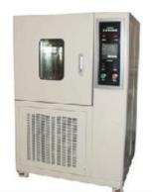
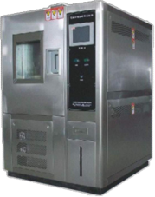
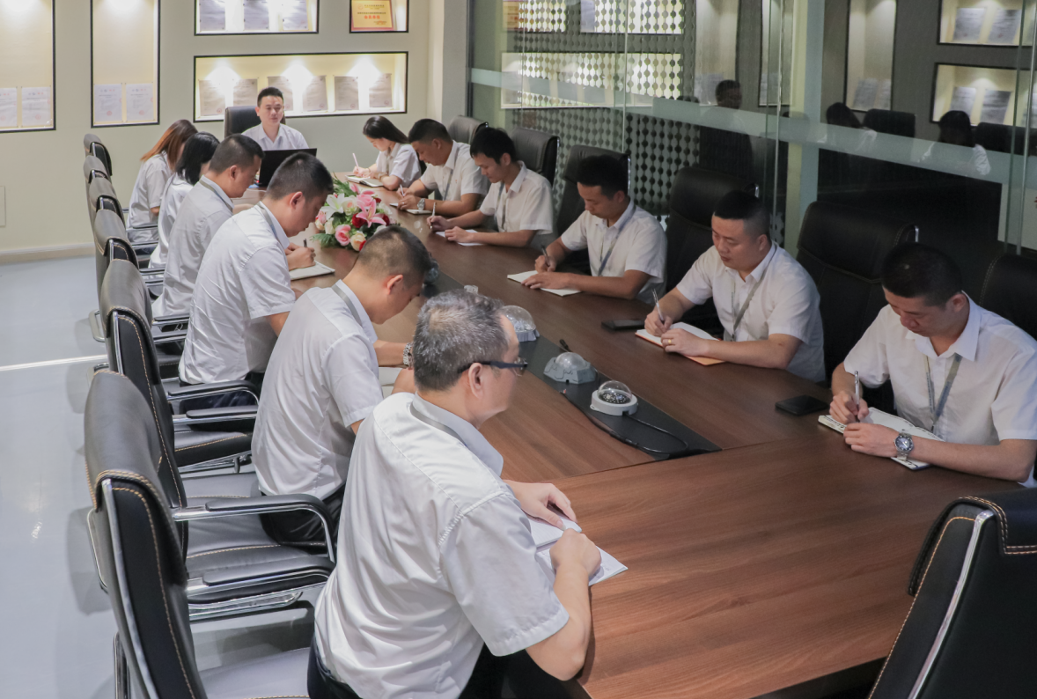
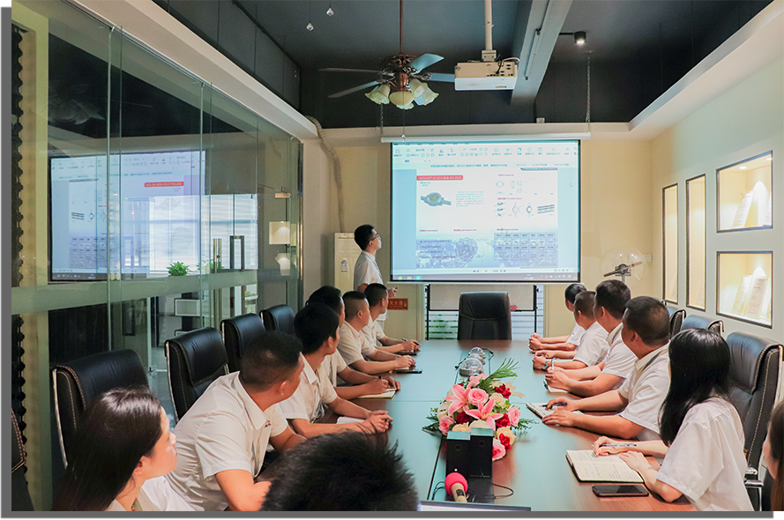

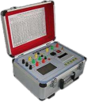

Company Style
Testing equipment
Medile has built modern standardized production lines and a comprehensive pre-sales and after-sales technical service team. The output of various landscape lighting fixtures has increased rapidly, and the company has served more than 6,000 customers at home and abroad to date.
Sound management systems and advanced quality inspection equipment are adopted. Every procedure including R&D and design, production and manufacturing, quality control and after-sales service is implemented in strict accordance with the company's advanced equipment management
regulations. Raw materials for products are sourced from well-known brands such as CREE and PinYuan. All processes from production to assembly operate in compliance with the quality management system, environmental management system and occupational health and safety management system.

Slide 5
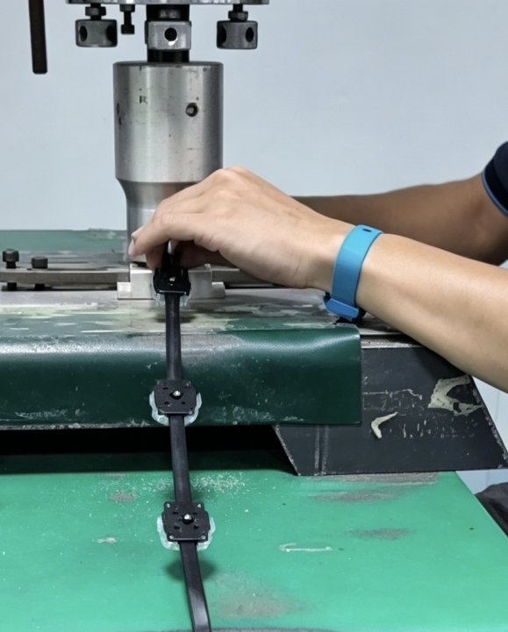
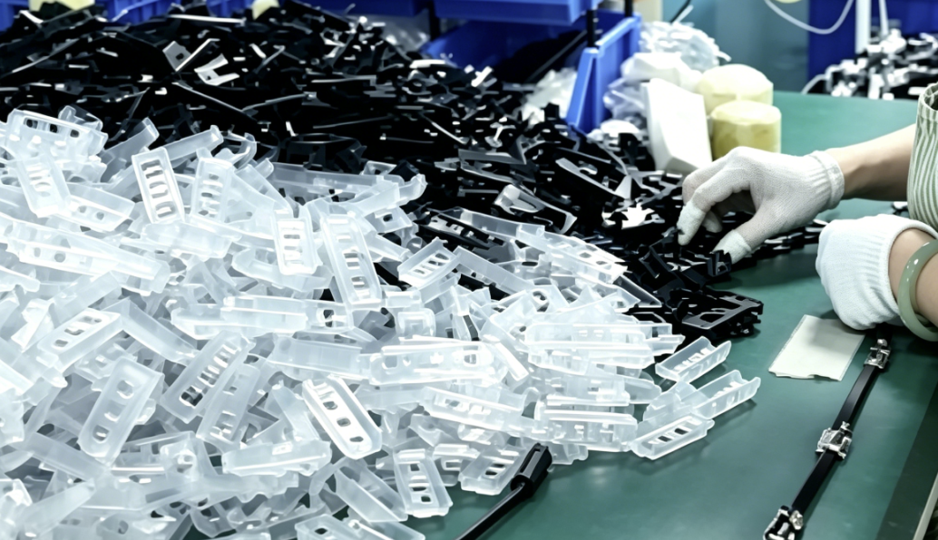
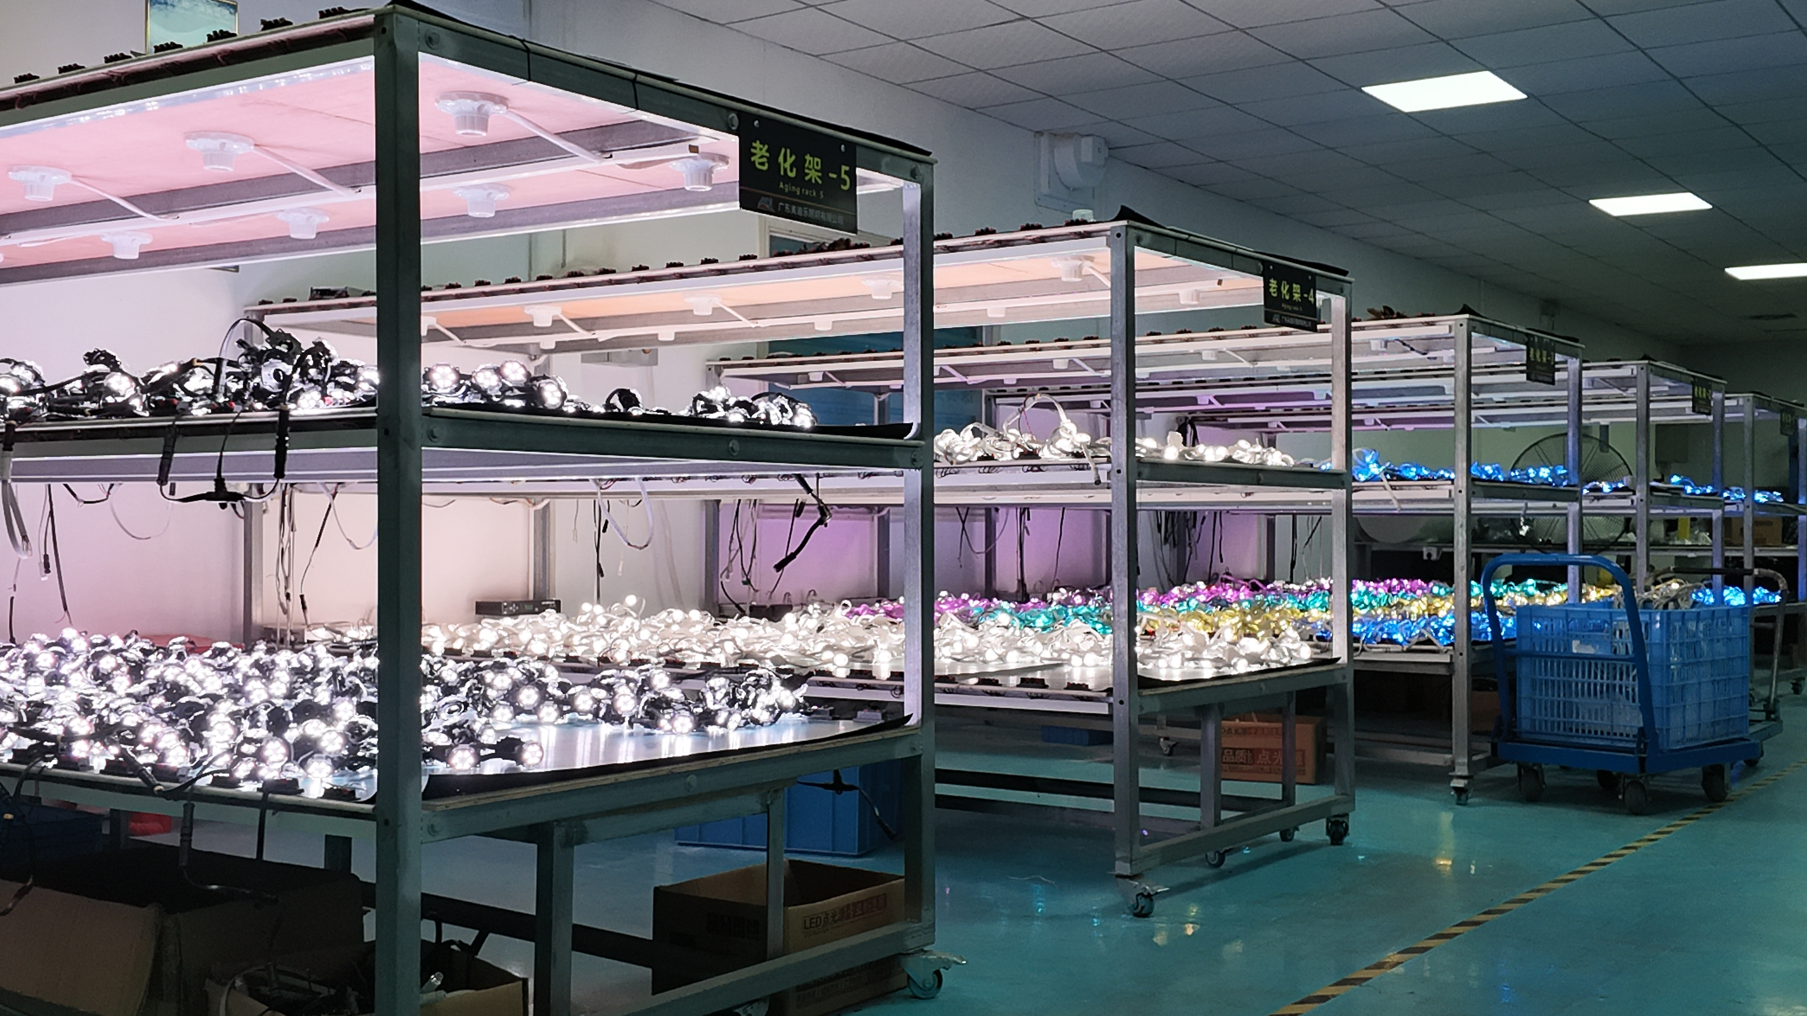
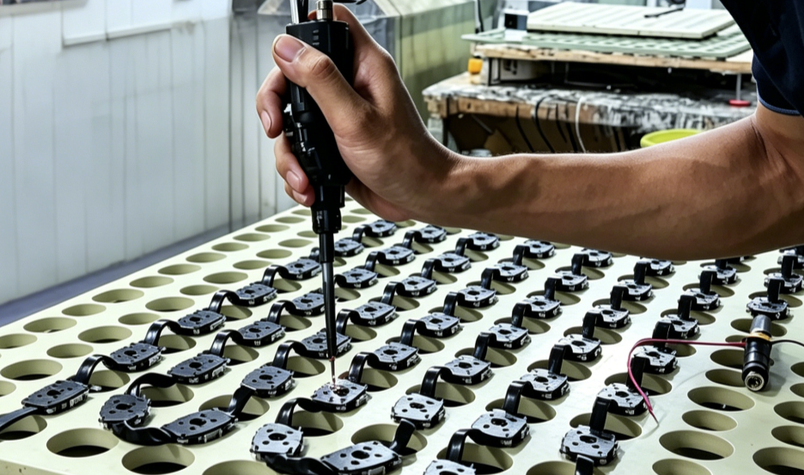
Team style
One-stop full-process standardized production plant area
Modern production workshops with a complete industrial chain layout realize closed-loop production from raw materials to finished products

Slide 6
Table of Contents
System Technical Application Solution
MDL-LED-Grid screen
M - Application Cases

Slide 7
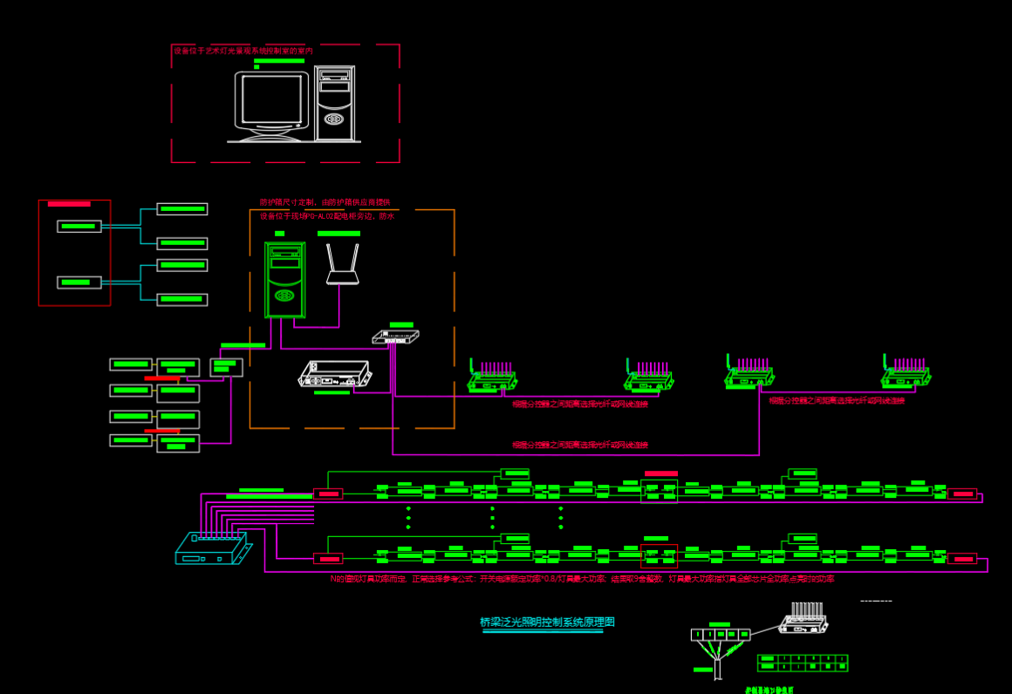
System Technical Application Solution
4. Built-in RS-485 interface (Modbus protocol) and UDP interface for connection with third-party devices.
5. Supports Bluetooth and mobile phone control, enabling real-time operation via PC and mobile APP. It also allows file replacement over local area networks and the internet.
6. Features scheduled playback and multi-level encryption functions.
Sub-controller Features：
1. The controller is designed with 8 output ports, and each port can carry up to 1024 pixels (TTL & Single-line DMX512).
2. The ports support two types of signal protocols:
① International standard DMX512/1990 protocol and extended DMX512 protocol;
② SPI/TTL serial protocol.
3. When driving DMX512 lights, the controller can output signals at rates of 250Kbps, 500Kbps and 750Kbps.
4. When operated via the Maijueshi software, each port of the controller can drive 1/2/3/4/5/6 units of lights
(1 unit = 170 lights).
Main Controller Features：
1. Quick and simple operation with real-time
monitoring of the controller status.
2. Powerful performance, supporting a maximum load of 160,000 pixels or 80 sub-controllers.
3. Equipped with a dual GPS/Beidou satellite synchronization module to achieve frame synchronization across multiple devices.

Slide 8
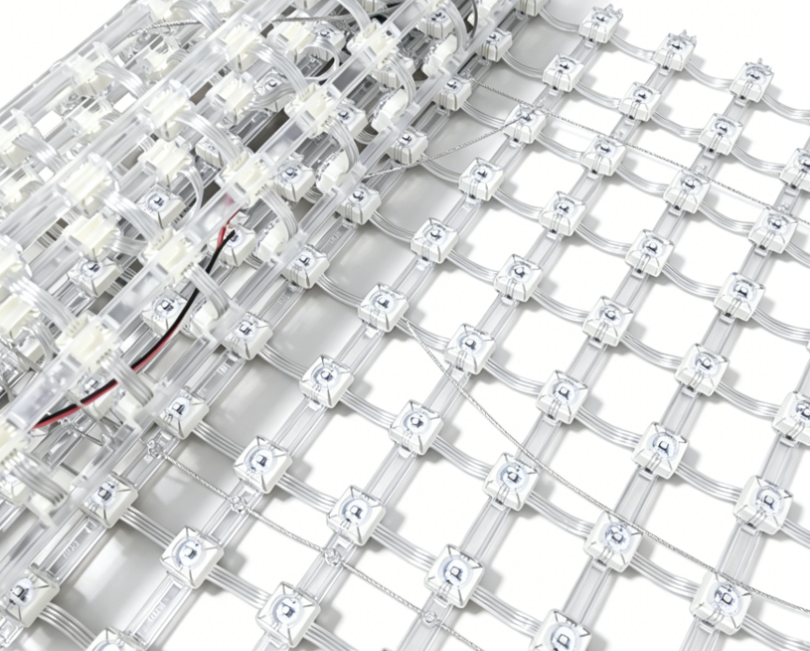
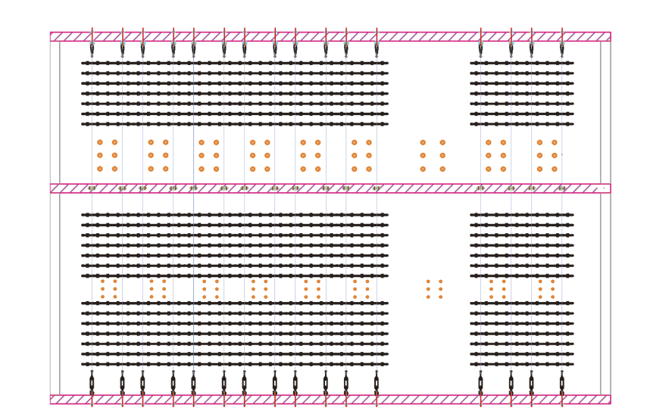
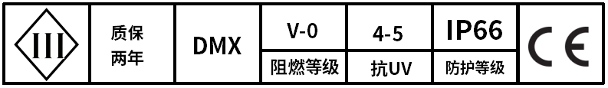
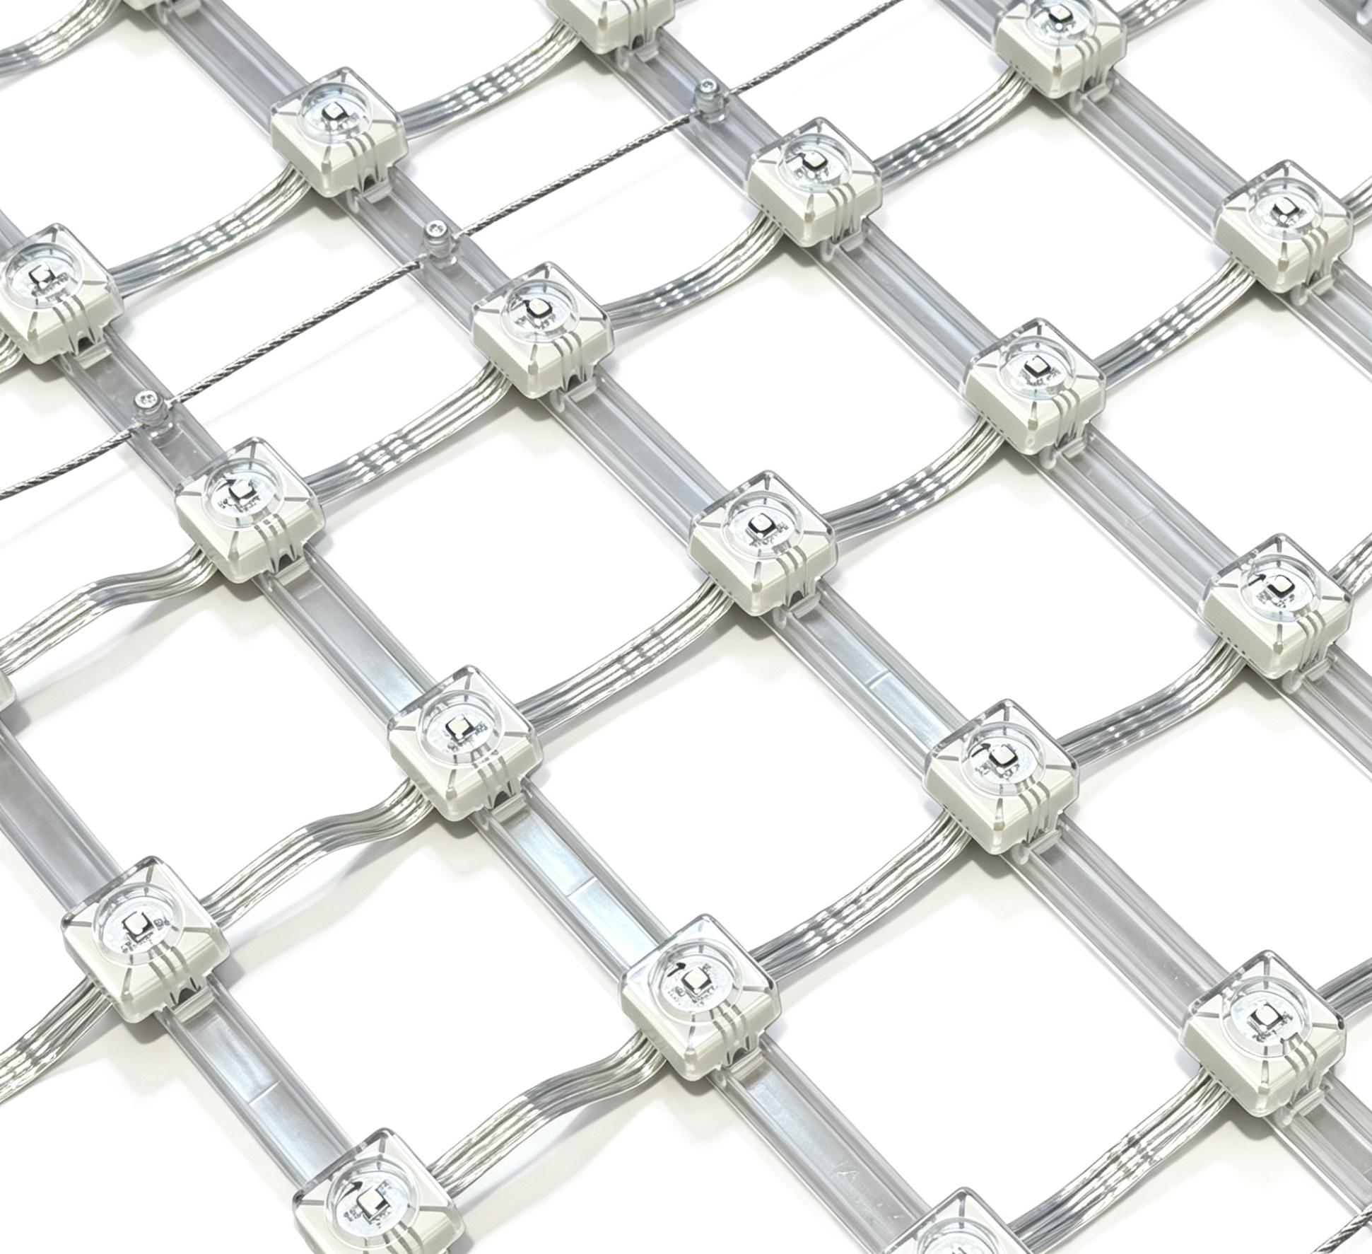
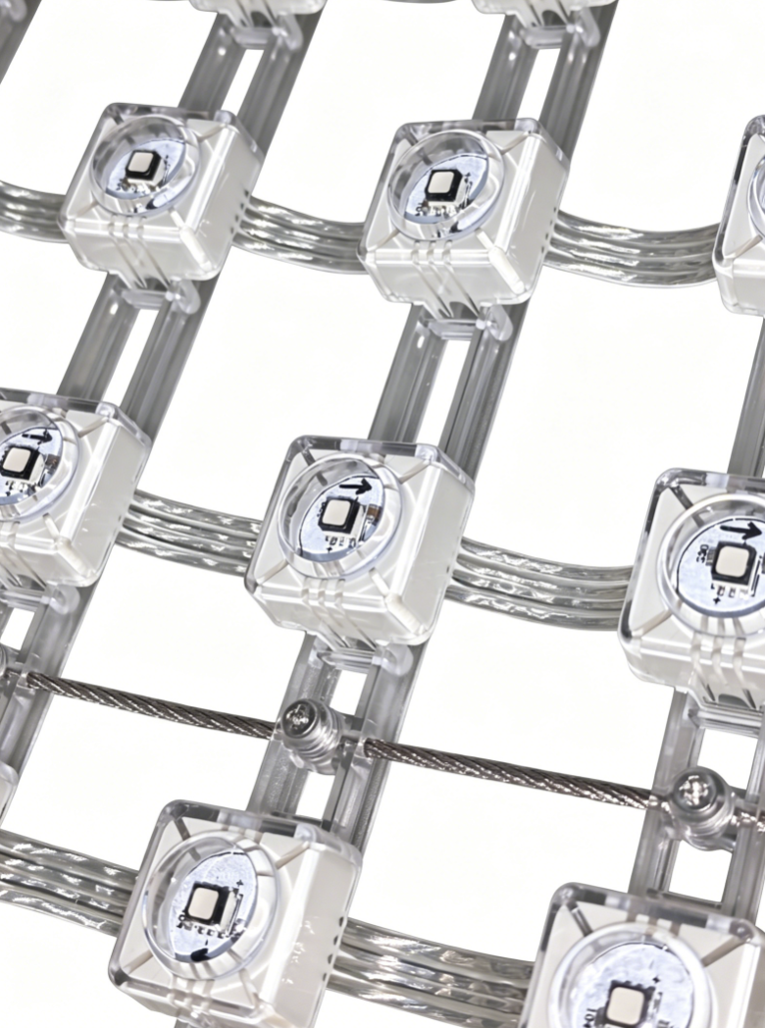
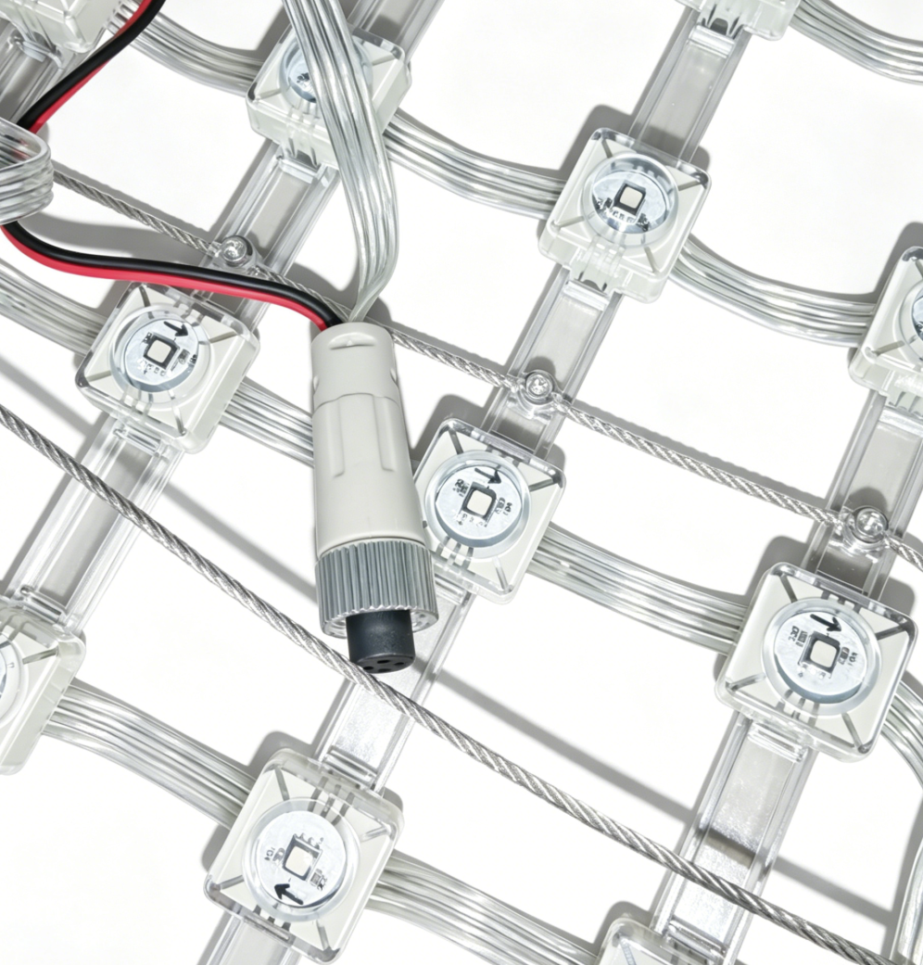
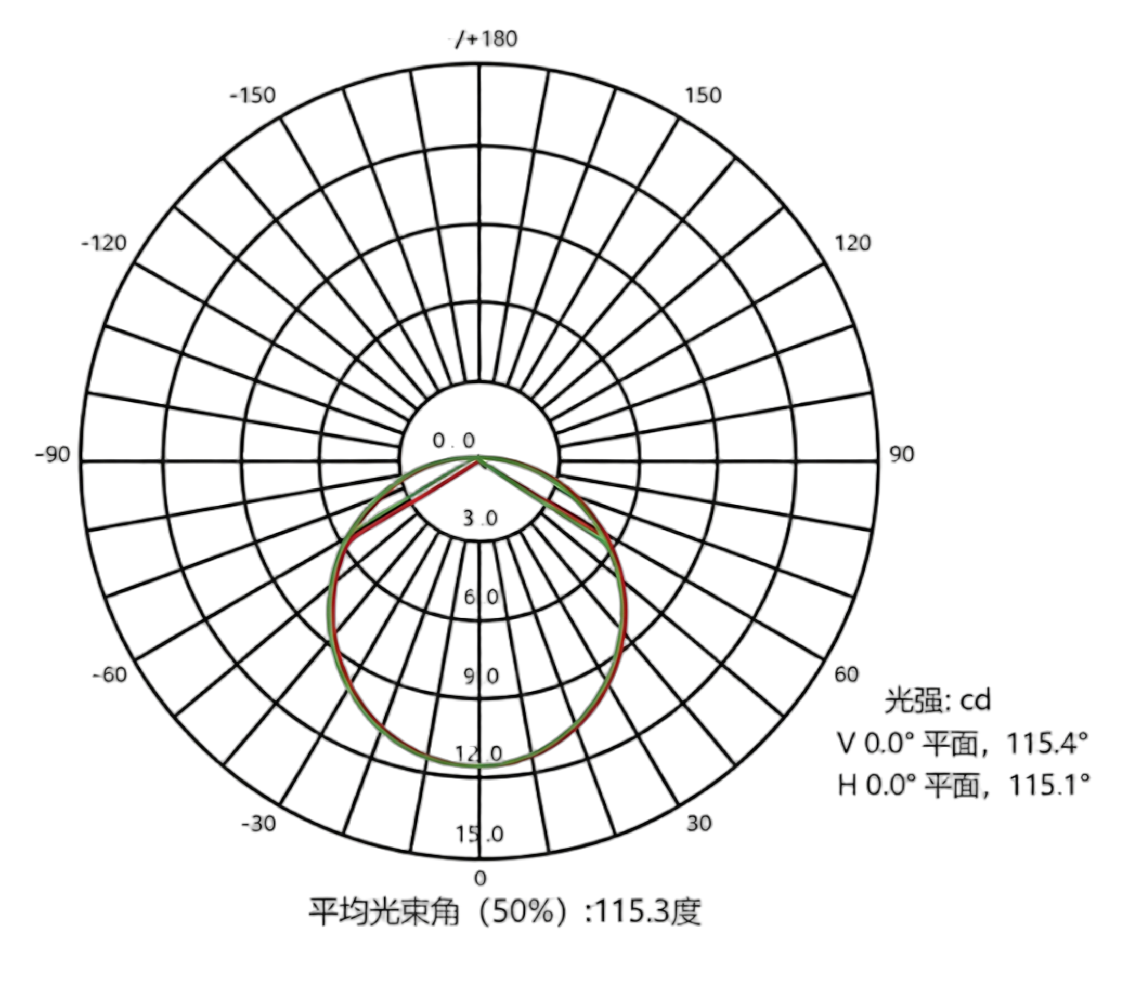
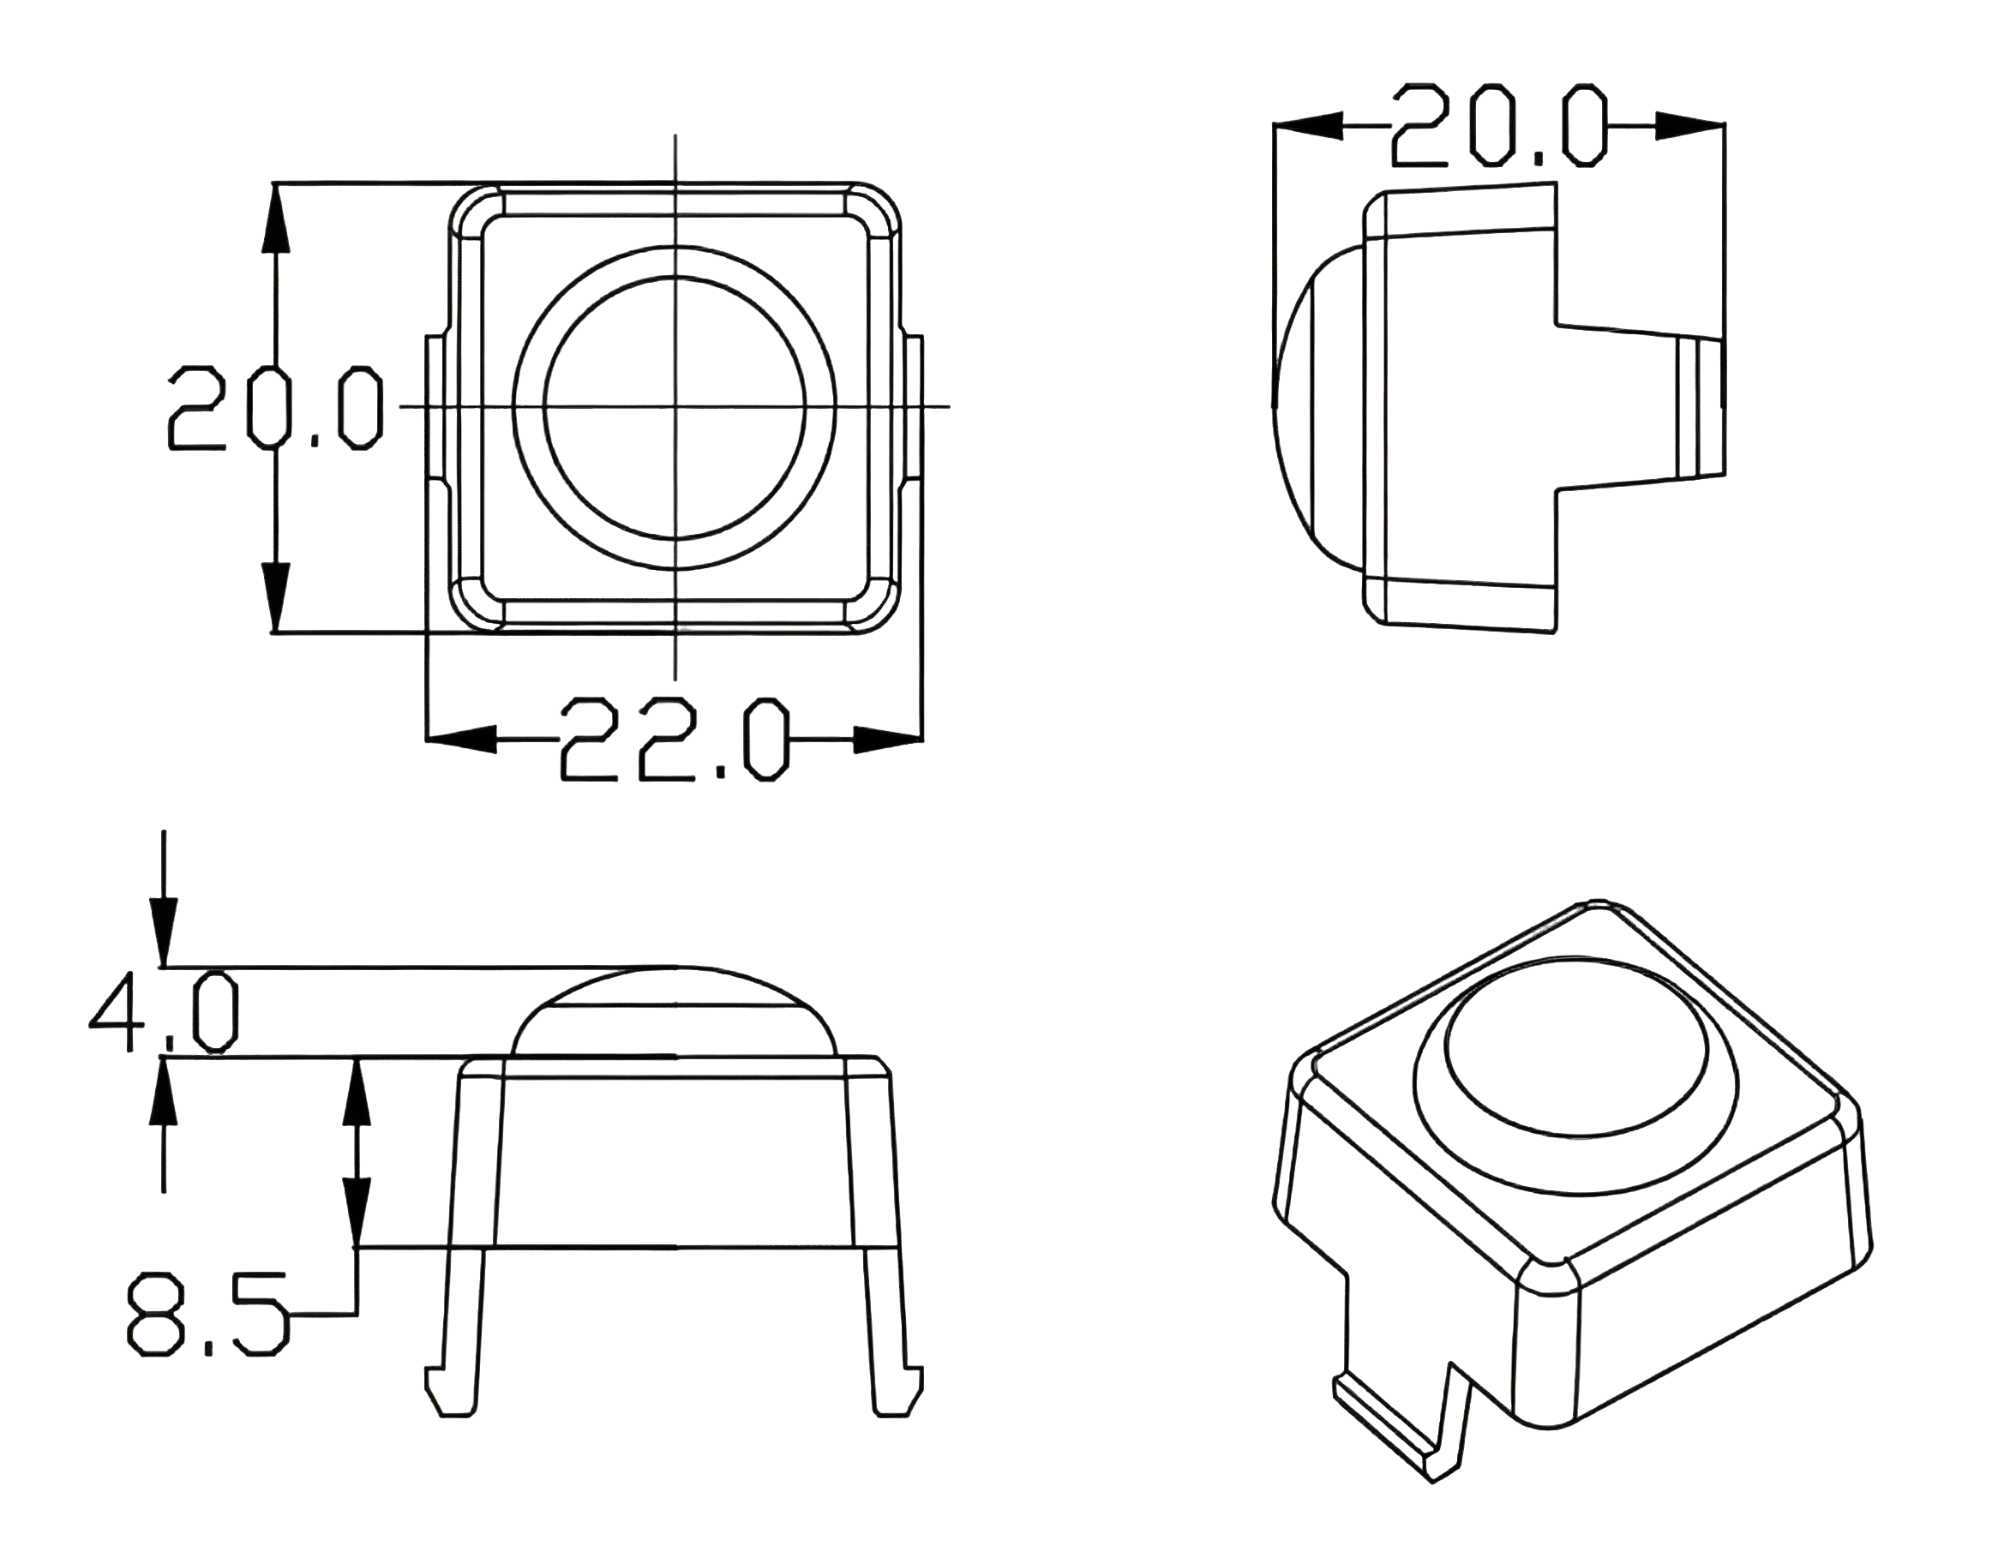
MDL-LED-Grid screen
Dot pitch | P83.3mm | P71.4mm | P62.5mm | P55.5mm | P50mm
Specification and Model | 12*12 | 14*14 | 16*16 | 18*18 | 20*20
Light source type | SM3535 | SM3535 | SM3535 | SM3535 | SM3535
Light source perspective | 120° | 120° | 120° | 120° | 120°
Composed of pixels | 1RGB | 1RGB | 1RGB | 1RGB | 1RGB
Pixel Density | 144pixels per/M² | 196pixels per/M² | 256pixels per/M² | 324pixels per/M² | 400pixels per/M²
Drive mode | outlay | outlay | outlay | outlay | outlay
Grayscale level | 256 | 256 | 256 | 256 | 256
Brightness | 252cd | 343cd | 448cd | 567cd | 710cd
Transmittance | 60FPS | 60FPS | 60FPS | 60FPS | 60FPS
Input voltage | DC12V | DC12V | DC12V | DC12V | DC12V
Maximum power per square meter | 43.2W | 58.8W | 76.8W | 97.2W | 120W
Refresh rate | 4K | 4K | 4K | 4K | 4K
Maximum power | 0.3w | 0.3w | 0.3w | 0.3w | 0.3w
Weight | 782.5g/M² | 968.2g/M² | 1141.5 g/M² | 1344.6 g/M² | 1541g/M²
service life | 30000H | 30000H | 30000H | 30000H | 30000H
Protection Class | IP66 | IP66 | IP66 | IP66 | IP66
Installation Diagram:
Spectral curve graph:：
Dimension Drawing:

Slide 9
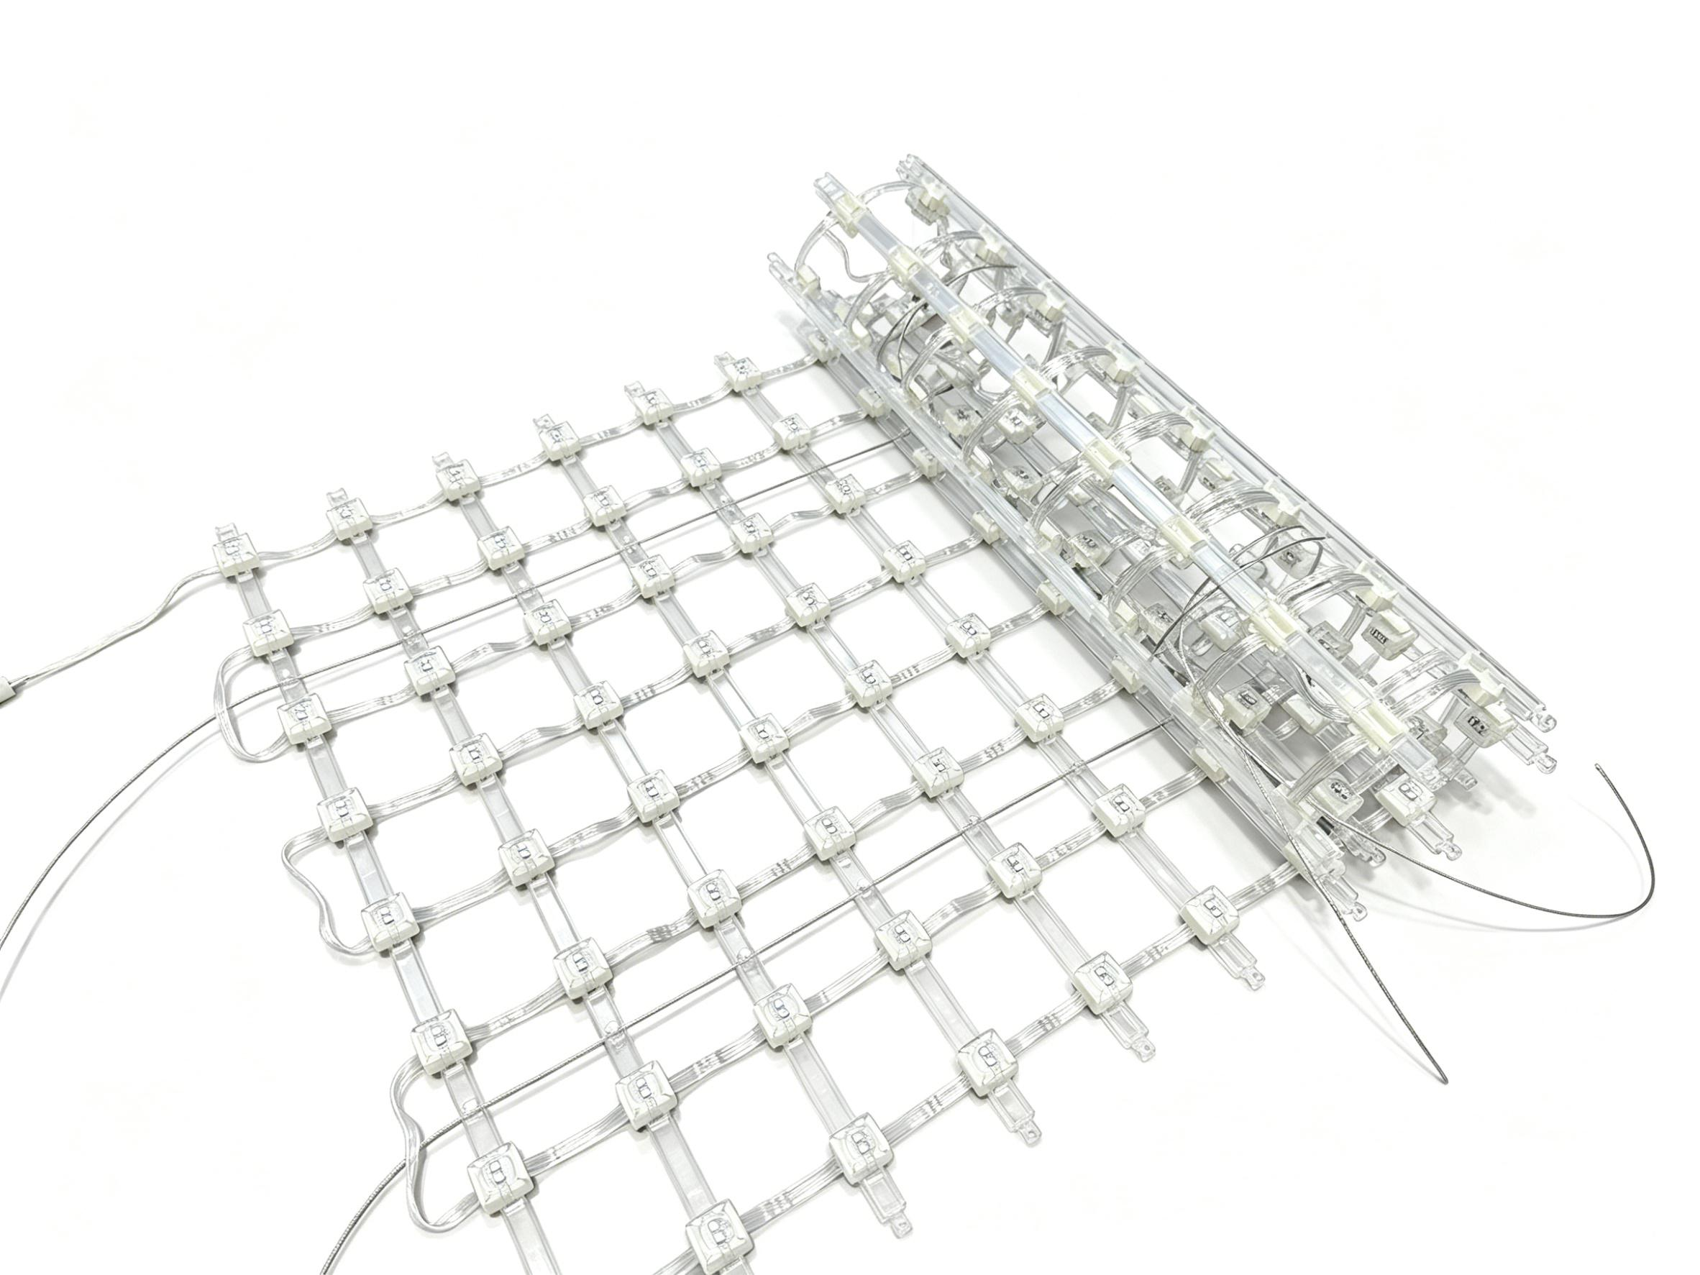
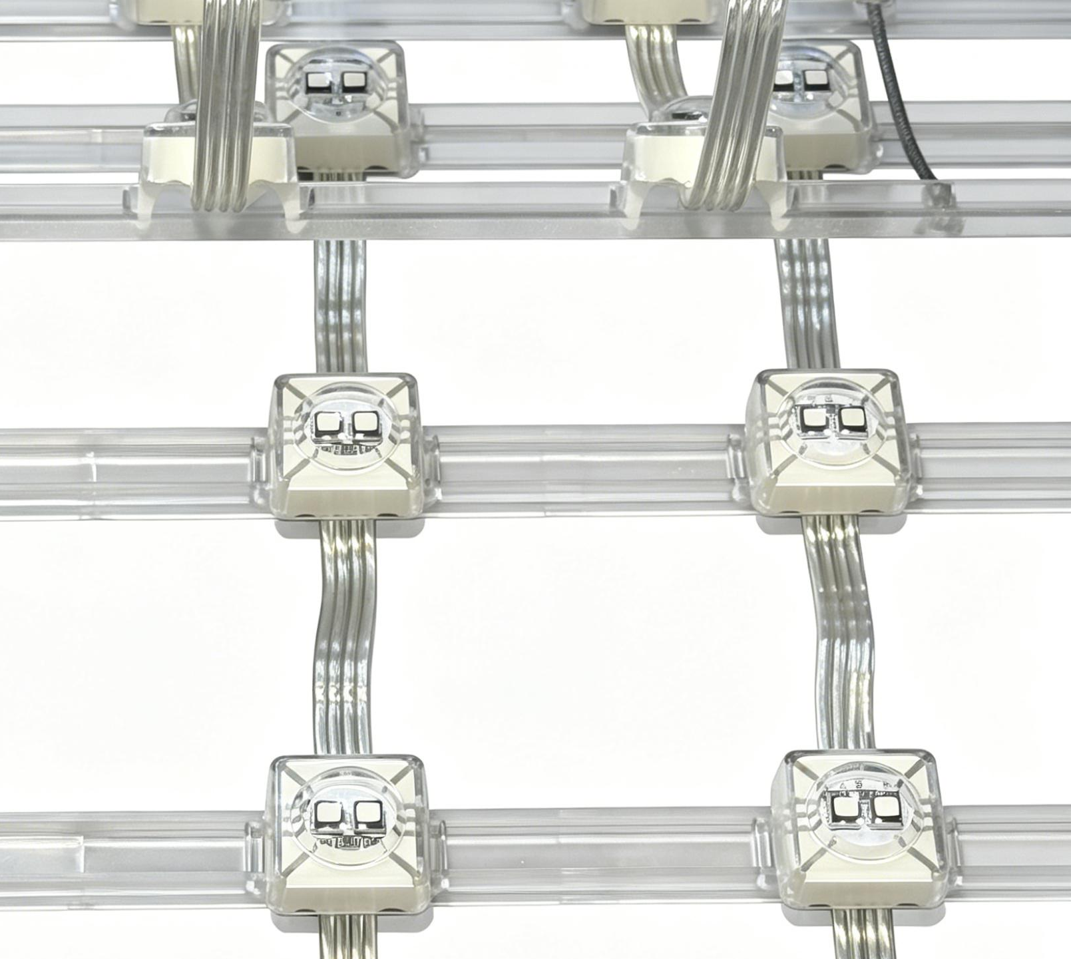
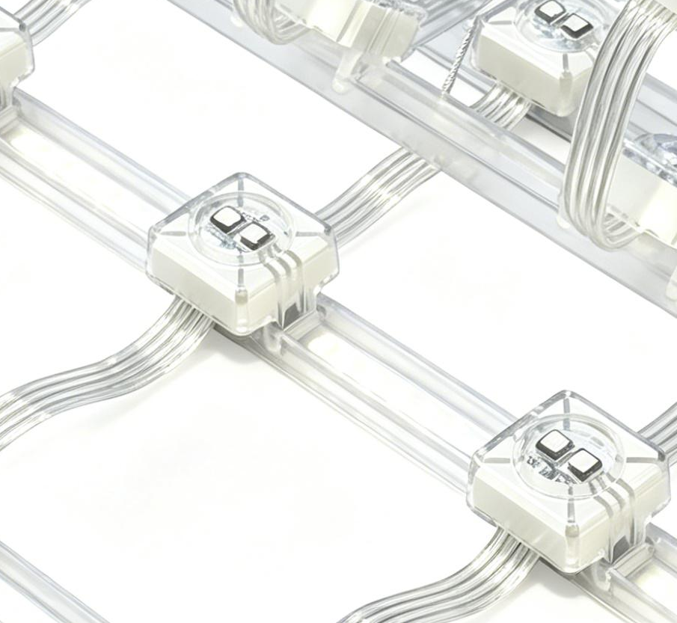
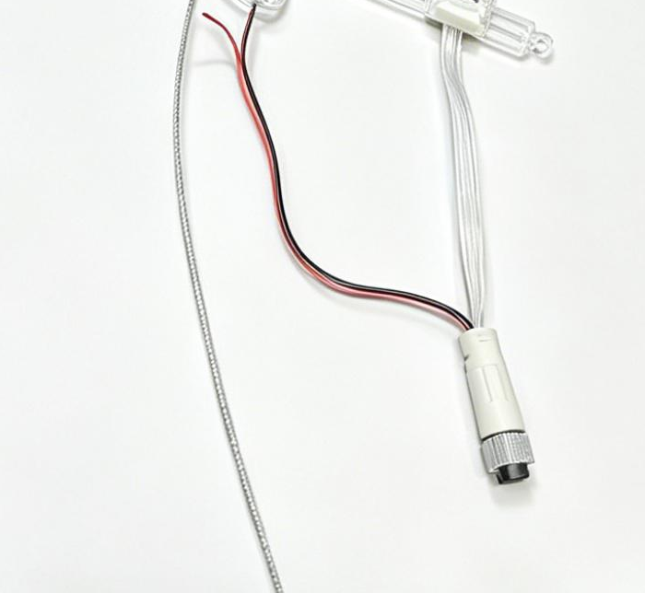
MDL-LED-Grid screen
Dot pitch | P83.3mm | P71.4mm | P62.5mm | P55.5mm | P50mm
Specification and Model | 12*12 | 14*14 | 16*16 | 18*18 | 20*20
Light source type | SM3535 | SM3535 | SM3535 | SM3535 | SM3535
Light source perspective | 120° | 120° | 120° | 120° | 120°
Composed of pixels | 2RGB | 2RGB | 2RGB | 2RGB | 2RGB
Pixel Density | 144pixels per/M² | 196pixels per/M² | 256pixels per/M² | 324pixels per/M² | 400pixels per/M²
Drive mode | External | External | External | External | External
Grayscale level | 256 | 256 | 256 | 256 | 256
Brightness | 504cd | 686cd | 896cd | 1134cd | 1420cd
Transmittance | 60FPS | 60FPS | 60FPS | 60FPS | 60FPS
Input voltage | DC12V | DC12V | DC12V | DC12V | DC12V
Maximum power per square meter | 103.68W | 141.12W | 184.32W | 233.28W | 288W
Refresh rate | 4K | 4K | 4K | 4K | 4K
Maximum power | 0.72W | 0.72W | 0.72W | 0.72W | 0.72W
Weight | 792g/M² | 976g/M² | 1144.5 g/M² | 1364g/M² | 1586.5 g/M²
service life | 30000H | 30000H | 30000H | 30000H | 30000H
Protection Class | IP66 | IP66 | IP66 | IP66 | IP65
Installation Diagram:
Spectral curve graph:：
Dimension Drawing:

Slide 10
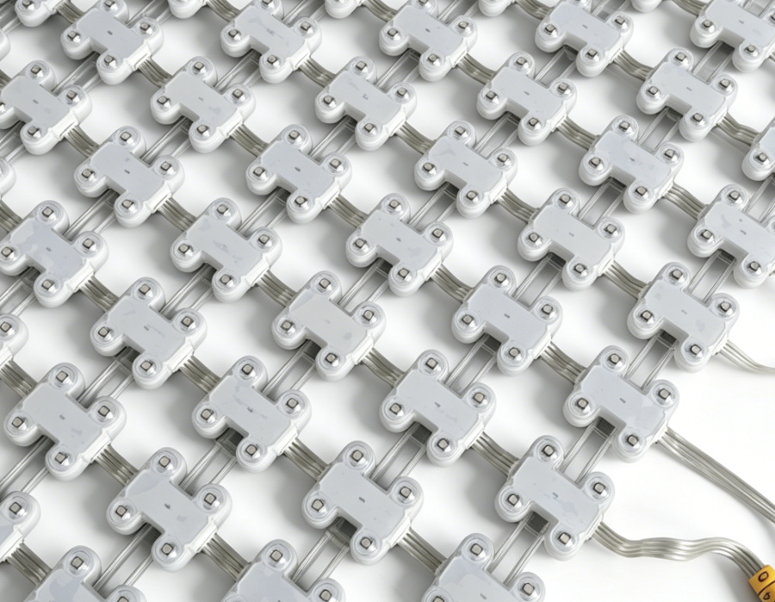
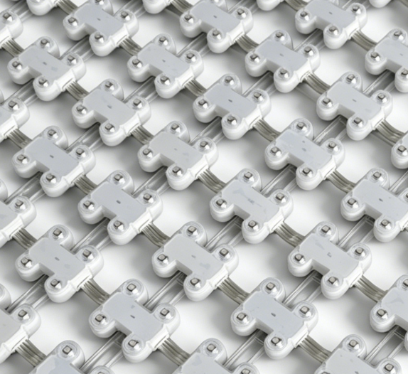
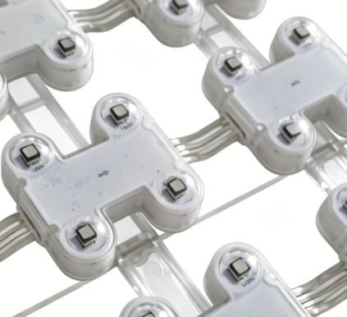
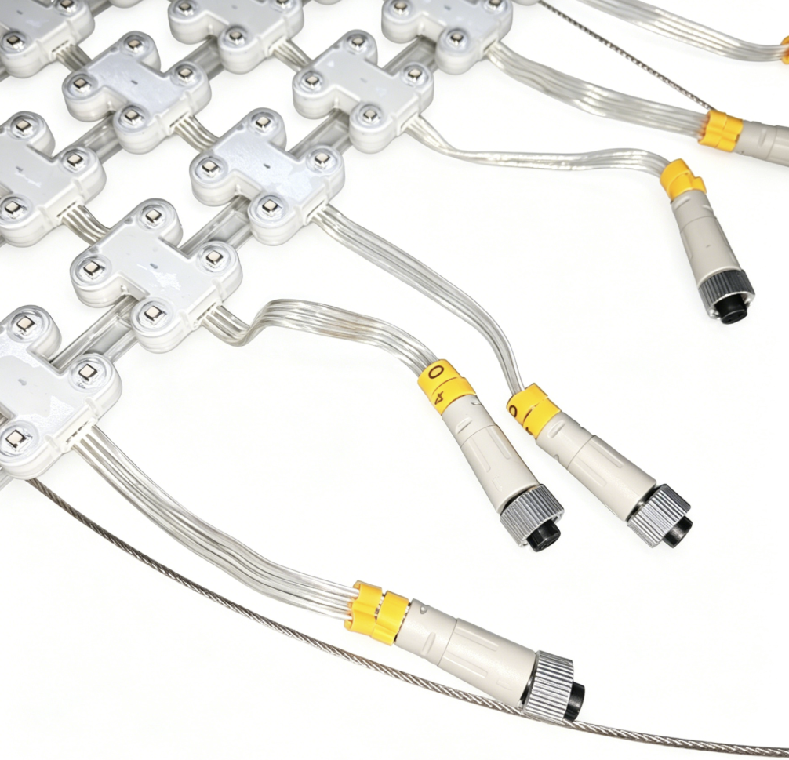
MDL-LED-Grid screen
Specification and Model | P25
Spacing | 25
Light source type | SMD3535
Light source perspective | 120°
Composed of pixels | 4RGB
Pixel Density | 1600 pixels per /M²
Drive mode | static
Grayscale level | 16bit
Brightness | 2800cd
Transmittance | 24%
Frame rate | 60FPS
Refresh rate | 3840
Input voltage | DC24V
Maximum power | 240W
Weight | 82000g/M²
service life | 30000H
Protection Class | IP66
Fire resistance rating | V0
Unit pixel | 40*40
Maximum cell size | 0.5*10m

Slide 11
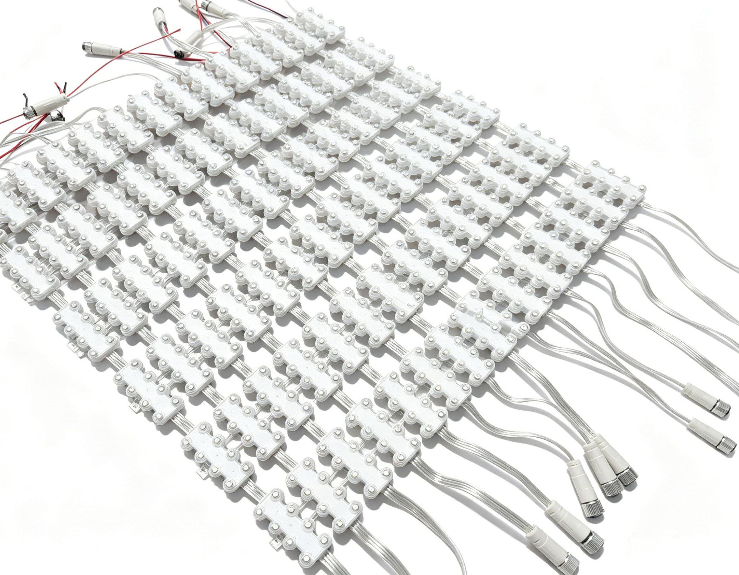
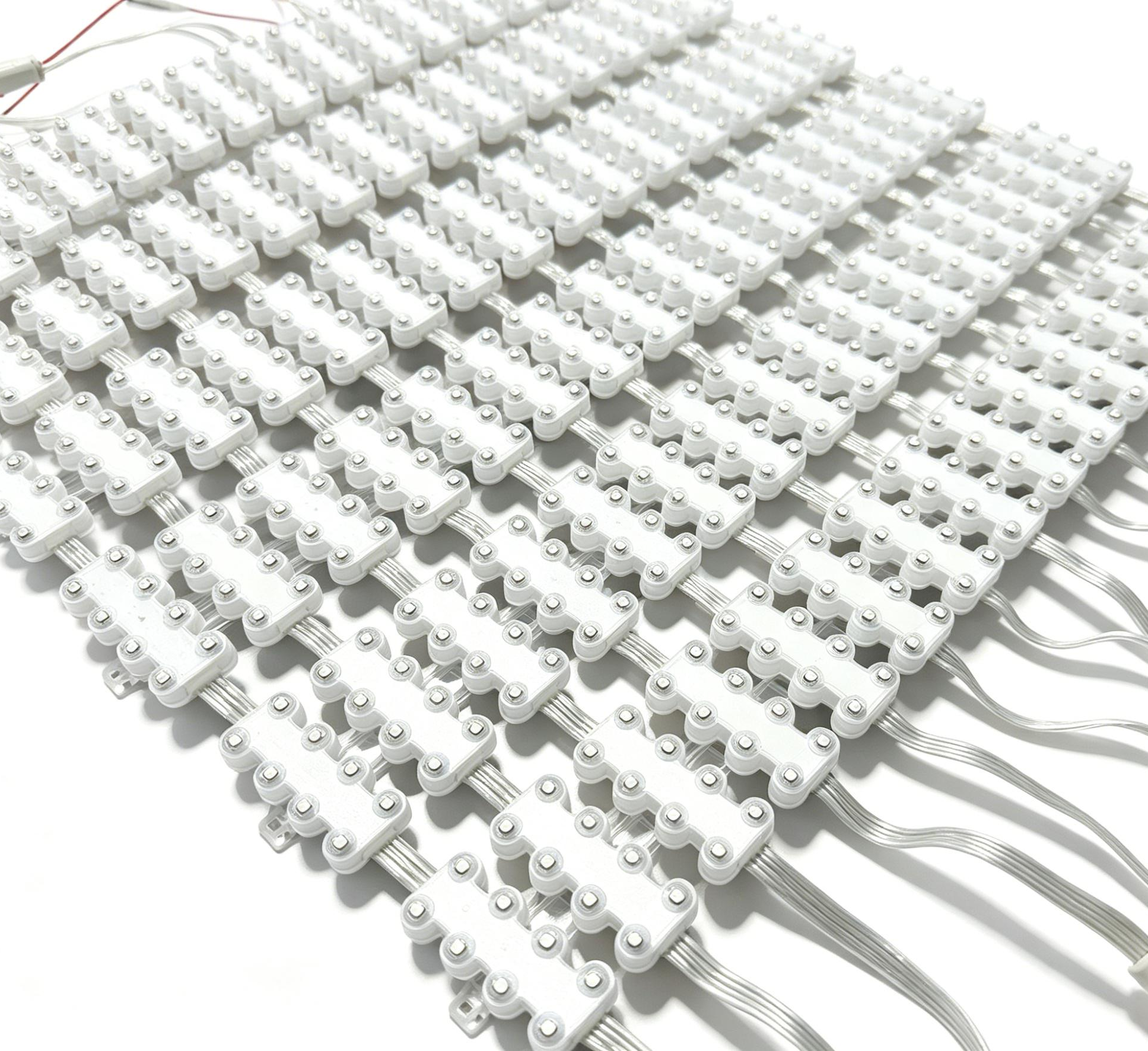
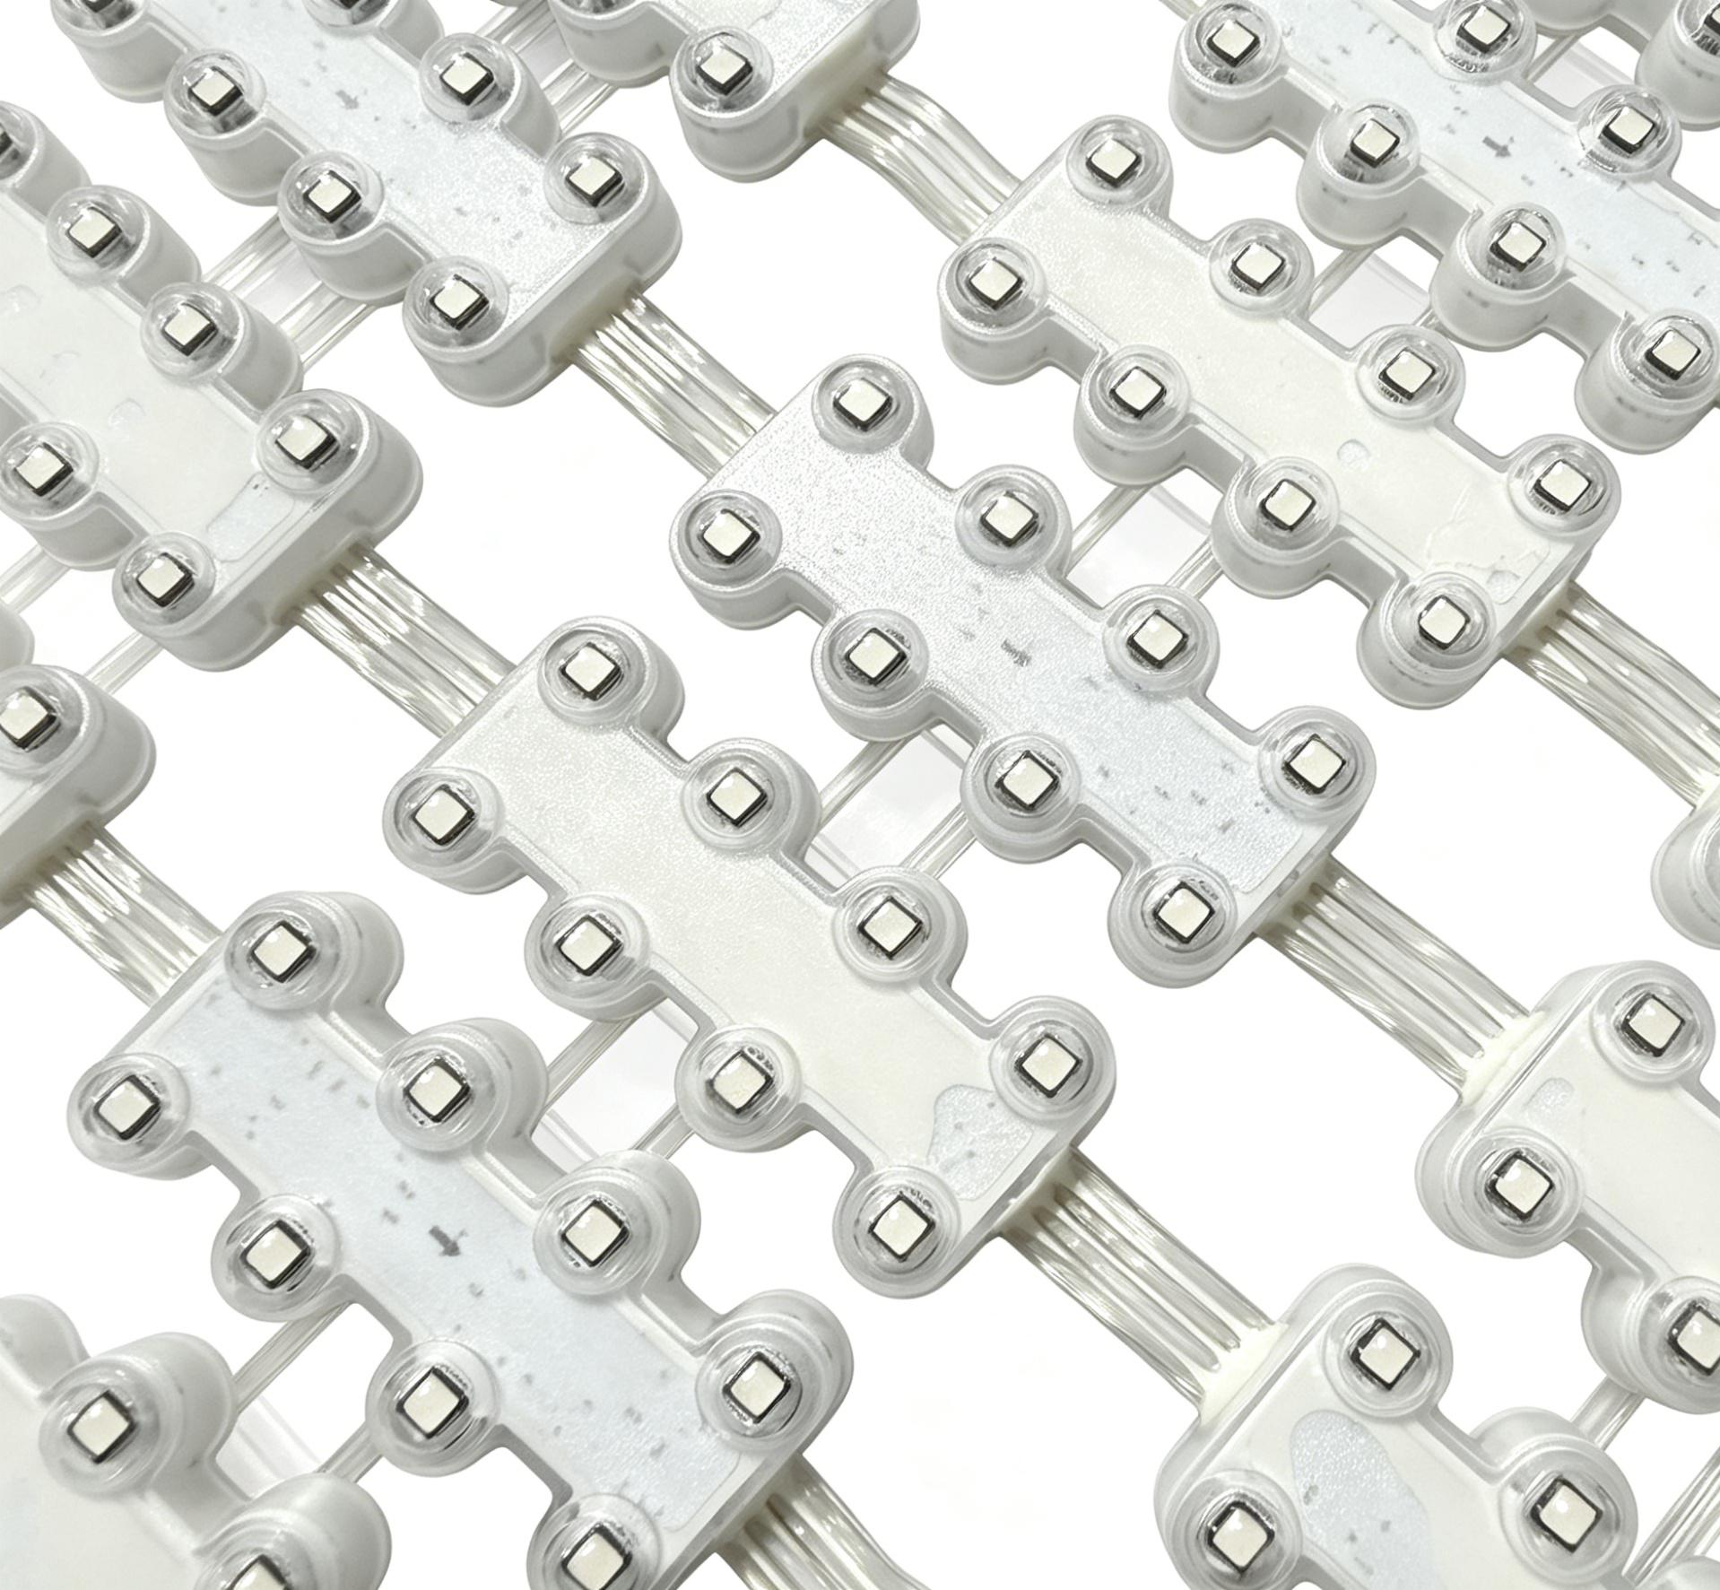
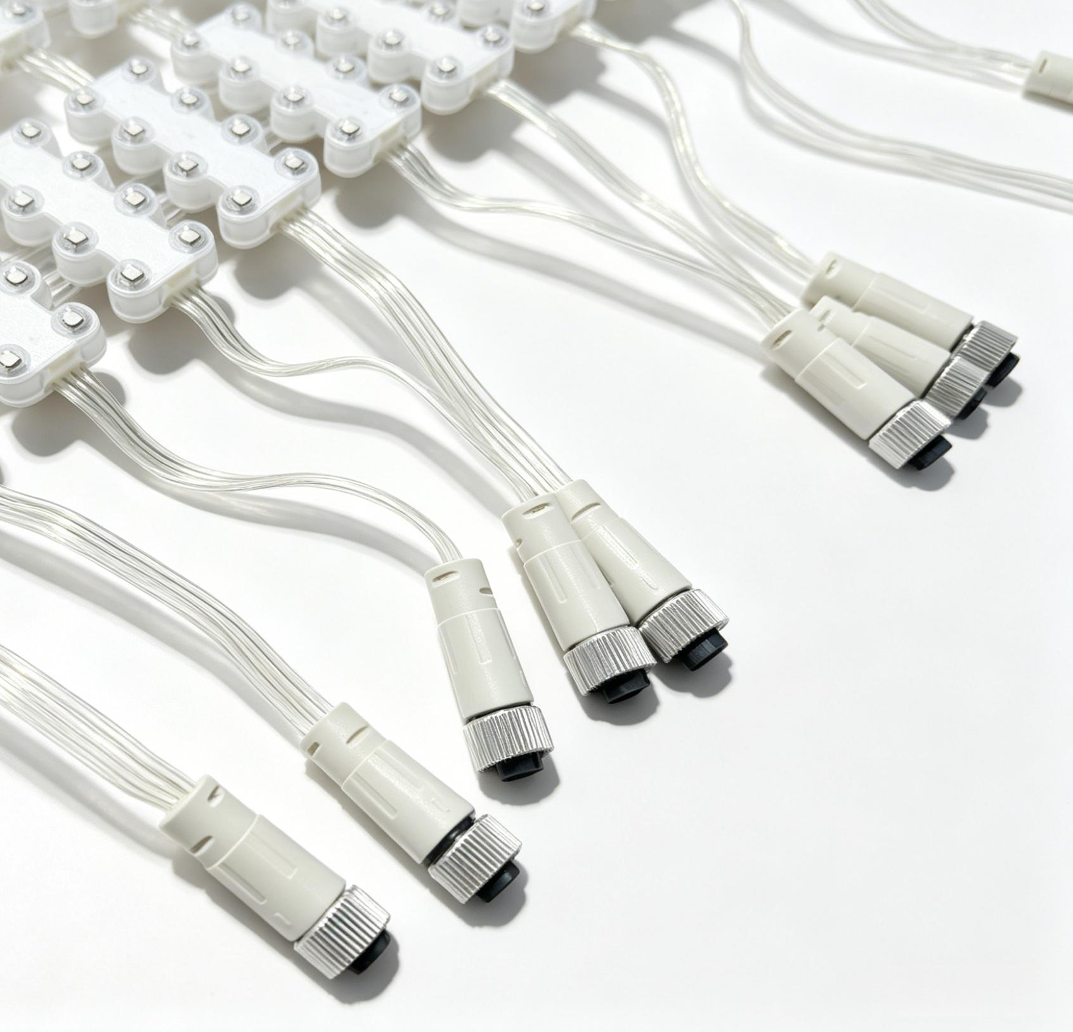
MDL-LED-Grid screen
Specification and Model | P15.625
Spacing | 15.625
Light source type | SMD3535
Light source perspective | 120°
Composed of pixels | 8RGB
Pixel Density | 4096 pixels per/M²
Drive mode | Static
Grayscale level | 16bit
Brightness | 7200cd
Transmittance | 39.2%
Frame rate | 60FPS
Refresh rate | 3840
Input voltage | DC24V
Maximum power | 614.4W
Weight | 10200g/M²
service life | 30000H
Protection Class | IP66
Fire resistance rating | V0
Unit pixel | 64*64
Maximum cell size | 0.5*6.25m

Slide 12
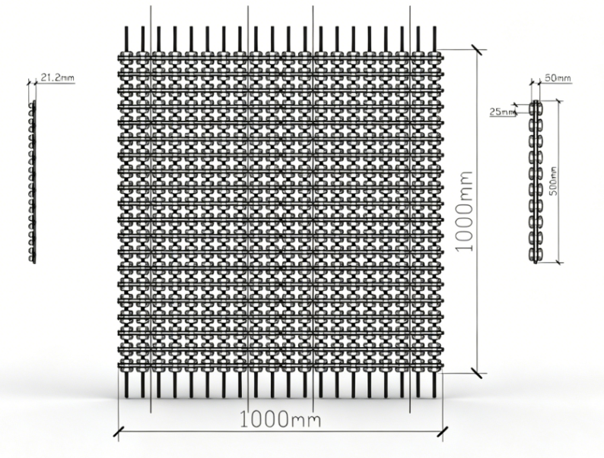
Dimension Drawing:
Product Overview：
The features of the LED mesh screen allow it to be installed with almost no need for steel structures. The waterproof transparent mesh screen is designed with a double-row light source structure, boasting ultra-light weight, ultra-thin thickness and high light transmittance.
It can also be installed in diverse shapes to meet the requirements of cultural tourism projects and stage styling. Leveraging the LED screen’s inherent transparency and slim profile, it delivers an outstanding see-through effect that extends the depth of field of the overall display. This enables images projected on the mesh screen to overlay real scenery behind, creating a spectacular immersive visual experience blending virtual and real elements with an illusionary aesthetic.
It supports direct operation with fixed single-color lighting, offline RGB digital control via CF cards, or real-time transmission of image, text and video signals through wired connection to a computer.
It weighs 8.2kg with a thickness of 22mm, supporting easy folding, disassembly and arbitrary cutting.
Its maximum transmittance reaches 39.2%. Featuring a snap-fit design for quick and convenient installation,
it guarantees uniform panel spacing and superior flatness alongside efficient maintenance.

Slide 13
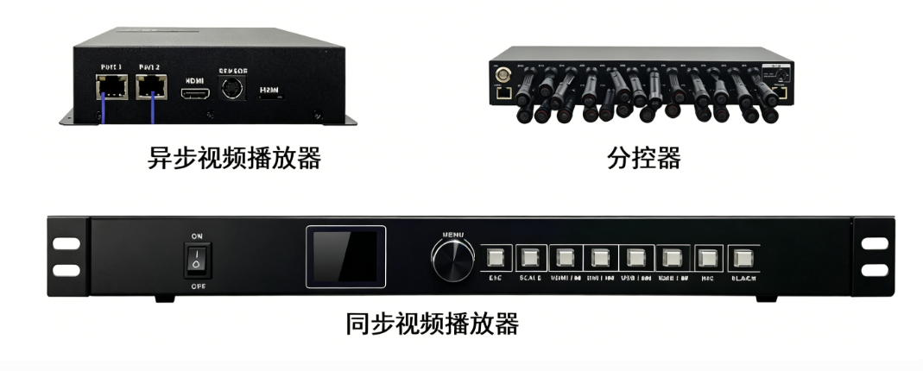
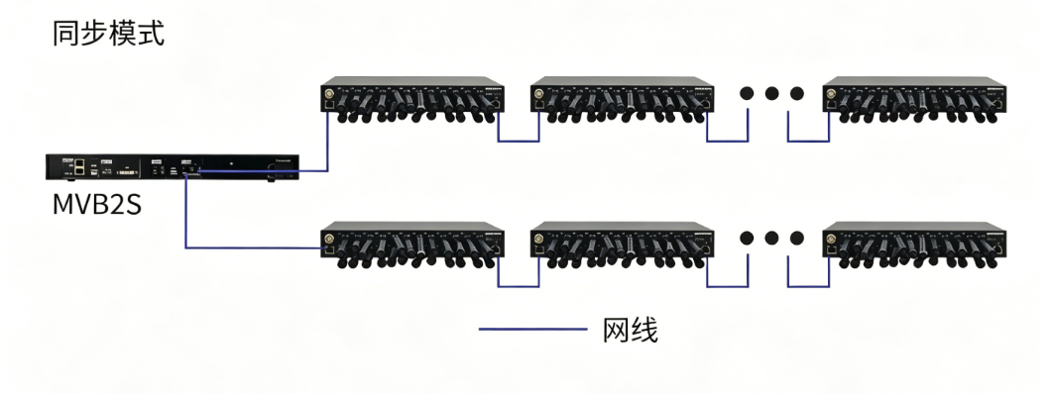
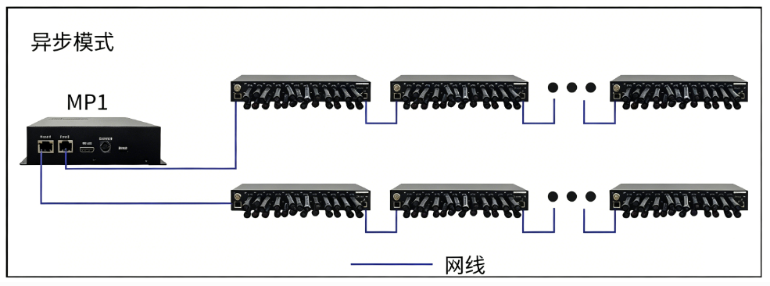
Control system
Asynchronous Video Player
Sub-controller
Synchronous Mode
network cable
Synchronized Video Player
Asynchronous Mode

Slide 14
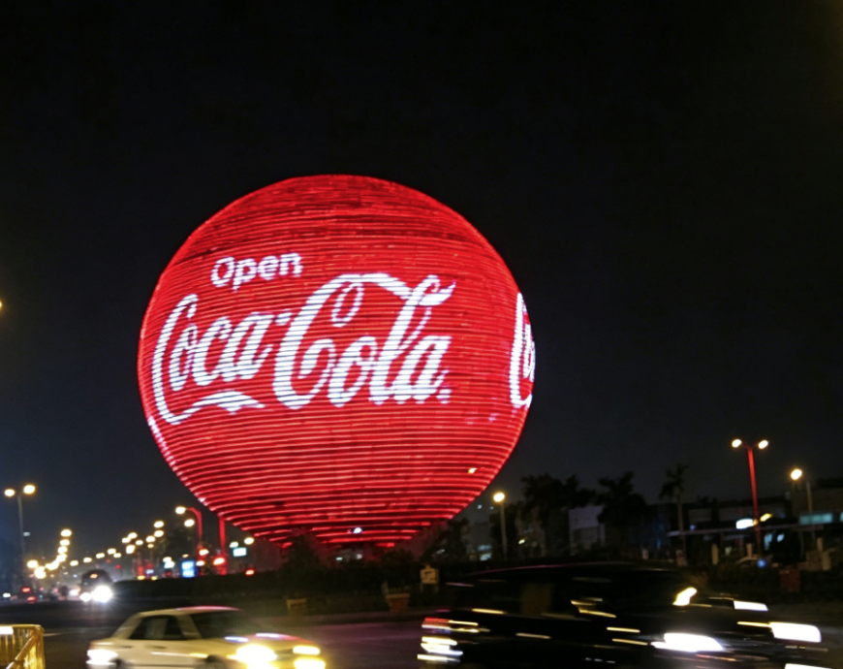
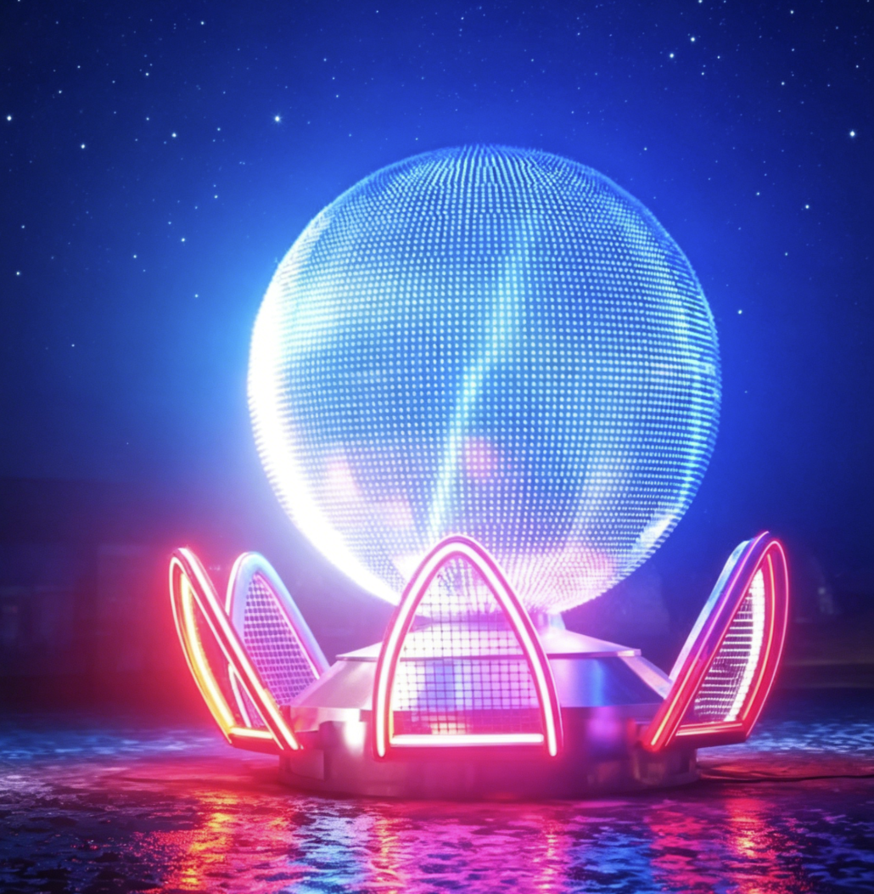
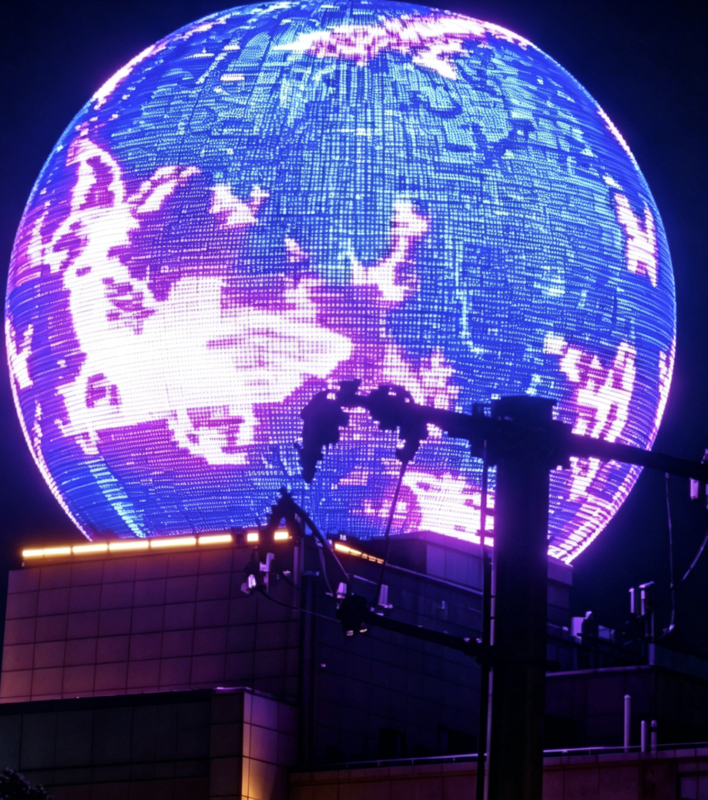
Spherical Light and Shadow Application Cases
Yinchuan, Ningxia
Qiqihar, Heilongjiang
2023 Gree Store, Yulin, Guangxi

Slide 15
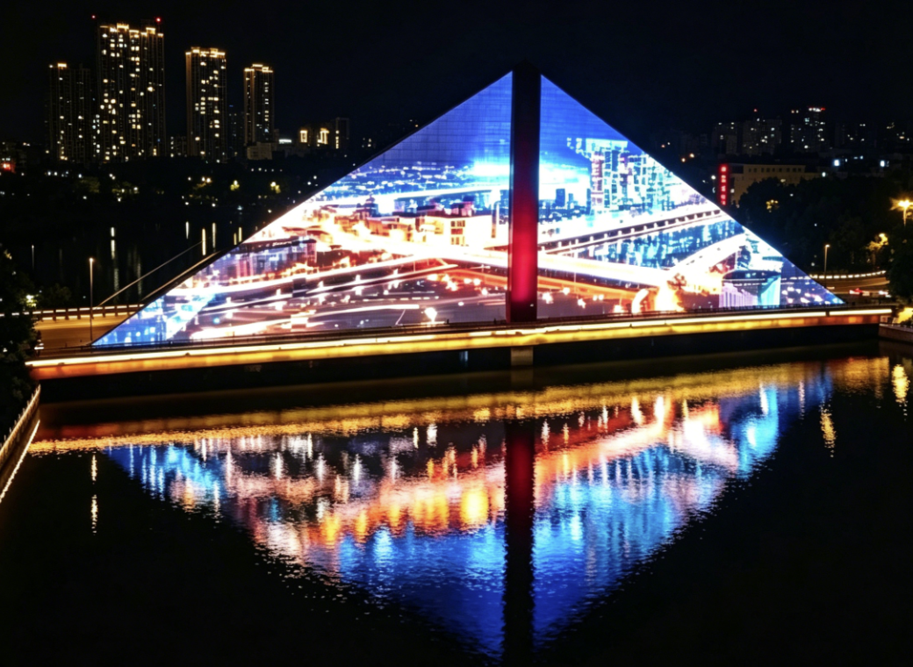
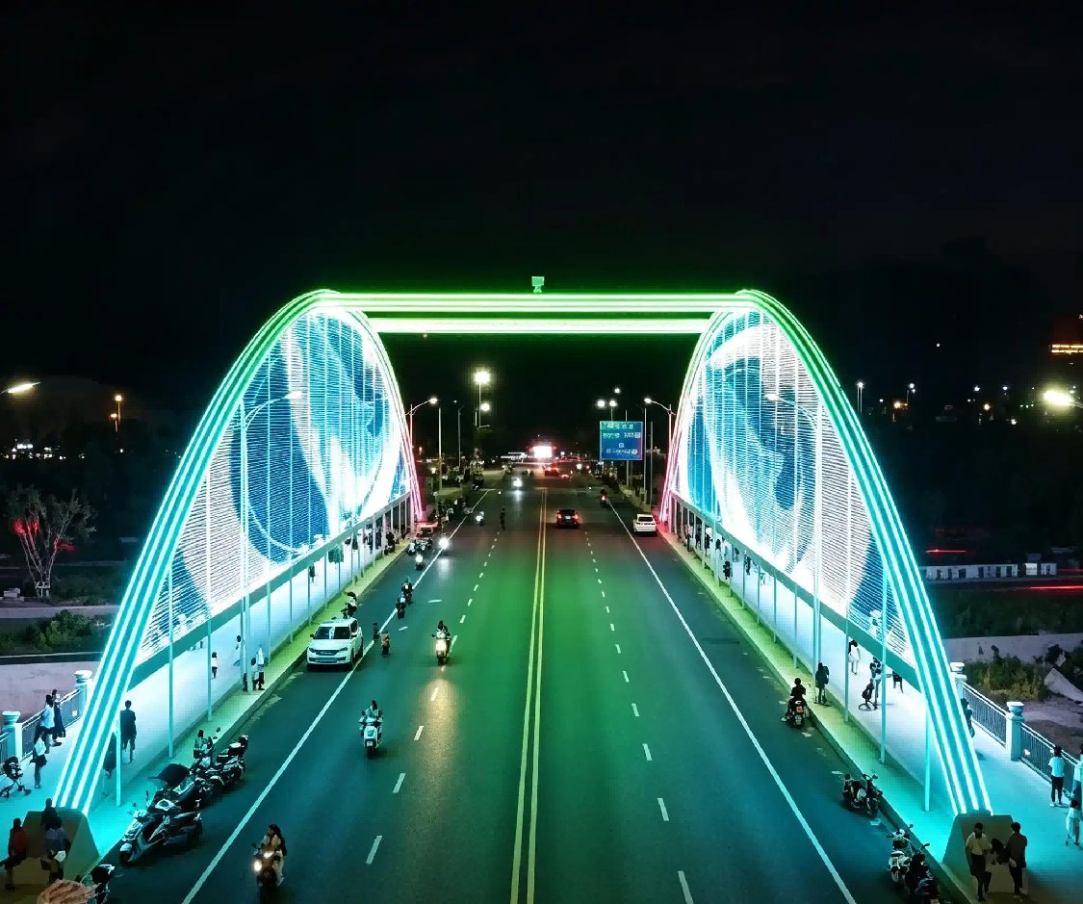
Bridge Lighting Application Cases
Liaohe East Bridge, Liaoyuan, Jilin

Slide 16
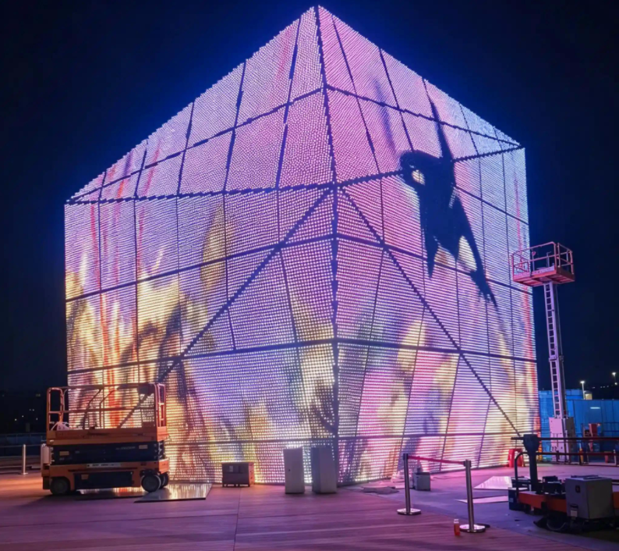
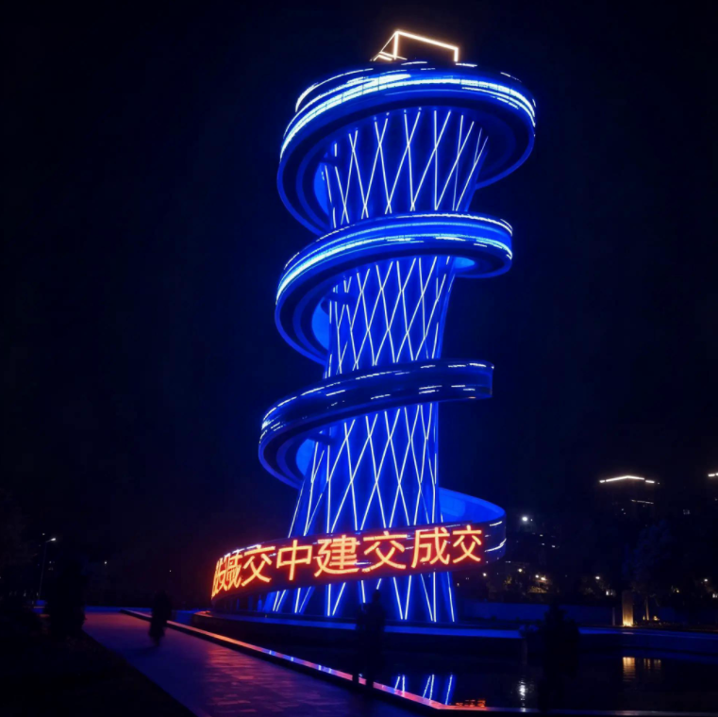
Application Cases of Characteristic Buildings
Zhanjiang, Guangdong as Guangzhouwan)
Hangzhou Sightseeing Tower, Zhejiang

Slide 17
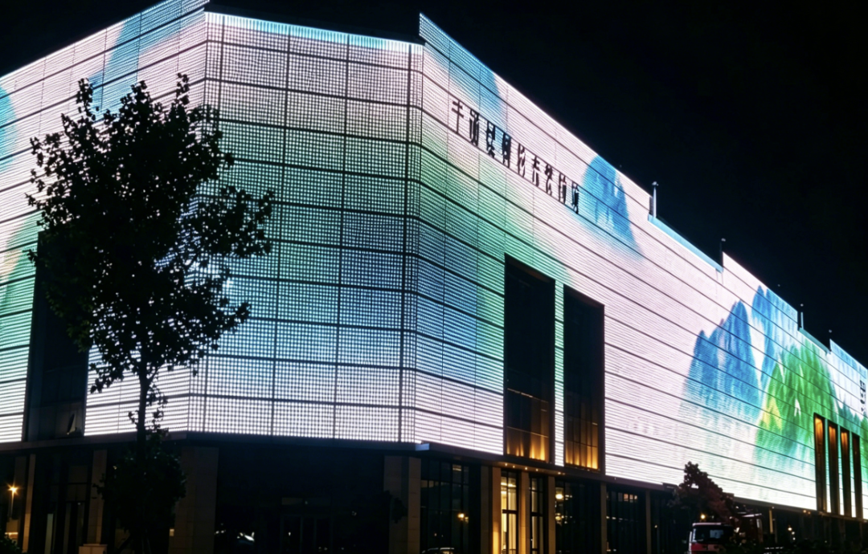
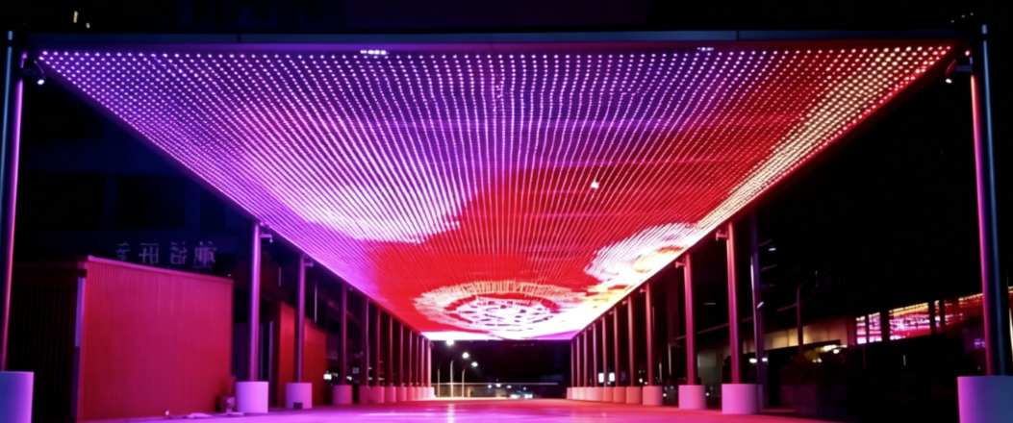
Grid Screen Cases
Changzhi, Shanxi, 2023
Guiyang, Guizhou

Slide 18


Application Cases of Art Lighting
Yan'an Eye, Yan'an City, Shaanxi Province
Huoqiu TV Tower, Lu'an, Anhui

Slide 19


Art Lighting Application Cases
Shangrao City, Jiangxi Province
Chengdu Tianfu Panda Tower

